Slide 1


PLATFORM · CONVERSATIONAL IVR
Smart IVR
Voice is the front door, not a phone tree.
A carrier-grade, standards-based IVR platform that resolves what it can, understands what it can't, and hands off with full context to a human agent — or a video call — on the same suite.
VoiceXML 2.x
Hundreds
6+
Cloud / on-prem
W3C standard
of calls per server
ASR/TTS/NLU vendors
deployment
2026 Product Brochure · Short edition

Slide 2
SMART IVR
THE AUTOMATED VOICE PLATFORM
A carrier-grade IVR that speaks any engine you choose.
Standards-based
VoiceXML 2.0/2.1, MRCPv2 and SIP — open, not proprietary.
Vendor-neutral speech
HTTP and MRCP connectors plug in the ASR, TTS and NLU vendor you already trust.
Deploy anywhere
Bare metal, VMware, KVM, or AWS, Azure and Google Cloud.
02

Slide 3





THE GAP
Everyone promises AI voice. Most still make you press 1.
Conversational AI is the pitch. In practice, buyers are asked to choose between a rigid legacy tree, a forced move to someone else's cloud, or a rebuild inside a brand-new bot-builder canvas.
Press 1 for menus, forever
Cloud-only, take it or leave it
Bot-builder lock-in
Smart IVR starts from telephony, not a chatbot canvas.
A standards-based VoiceXML engine with open speech-engine connectors, and — as of August 2026 — an AI Agent Gateway that sits alongside VoiceXML rather than replacing it, so existing applications keep running.
Microsoft is retiring Nuance's on-premise Conversational IVR stack — sustaining support for on-prem installs ends June 2026.
Positioning based on published capability and roadmap pages of leading IVR/CCaaS vendors, reviewed August 2026
The gap
2

Slide 4







THE PLATFORM
A carrier-grade IVR that speaks any engine you choose
Smart IVR is a software-based, 100% packaged conversational IVR platform, VoiceXML 2.X compliant with extended tags, built on an open-standards core. It runs on your own servers, on a virtual machine, or in the cloud.
Standards-based
Carrier-grade
Vendor-neutral speech
Deploy anywhere
VoiceXML 2.0 and 2.1 (W3C), MRCPv2 (RFC 6787) and SIP (RFC 3261 / 5552) — open, not proprietary.
Multi-tenant architecture built to process hundreds of simultaneous calls per server.
HTTP and MRCP connectors plug in the ASR, TTS and NLU vendor you already trust — not a walled garden.
Bare metal, VMware, Proxmox and KVM, or AWS, Azure, Google Cloud and OVH — your choice.
VoiceXML 2.0/2.1
MRCPv2
SIP
Per port
W3C compliant
RFC 6787 speech control
RFC 3261 / 5552
subscription or licence
Source: wiki.ivrpowers.com/en/smartivr/start, /resources/references
The platform
3

Slide 5





DIFFERENTIATOR
What it means for voice to be a real front door
Not a bot bolted in front of the phone system. The telephony layer and the conversation layer, designed to work as one.
Owns telephony end to end
Hands off with context
Coexists with new AI
SIP trunking, DID numbering, PBX/CCaaS interconnection, barge-in and transfer — natively, not bolted on.
Call variables and conversation context carry through to Web ACD's queue and agent desktop at escalation.
The AI Agent Gateway lets a connected AI own conversation while Smart IVR keeps owning telephony — no rebuild.
Vendor-neutral speech
Escalates to a real video agent
One telephony layer, one vendor
Any MRCP- or HTTP-compatible ASR, TTS or NLU engine plugs in — Nuance, Verbio, Lumenvox, Google, Amazon, Azure.
A call that needs a human can route into the same suite's Web ACD queue — voice, or face to face over video.
IVR, ACD and video all run on the same open-standards core, not stitched together from separate SKUs.
Entry points: any carrier or VoIP system over standard SIP trunking — no proprietary handset or app required.
Source: wiki.ivrpowers.com/en/smartivr/v2/faq, blog.ivrpowers.com (Aug 2026)
Differentiator
4

Slide 6
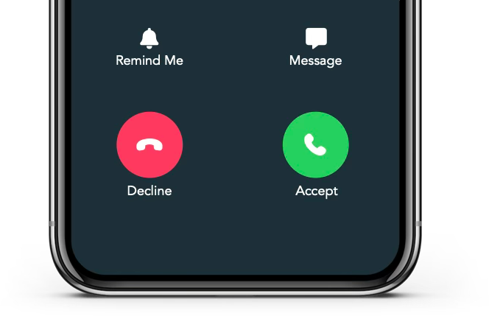





Did you know you can take your company's calls
to the next level with Natural Language and AI?
<vxml> version="2.x"
Interactive Powers

Slide 7






CAPABILITIES
Self-service, administration and security — one engine
Mixed-initiative conversation
Barge-in enabled
VoiceXML code editor
Natural-language mode via the native <nlu> element lets callers say what they want.
Callers can interrupt a prompt at any point — standard VoiceXML behaviour, honoured throughout.
Create, edit and upload .vxml, .php and .wav files in the browser, with syntax colouring.
IVR Watchdog
Encrypted media
License-gated capacity
A scheduled job restarts failed components automatically — self-healing without a human on call.
SRTP over the RTP media path, added via the res_srtp module in v2.4.0.
Channel count, ASR/TTS enablement and expiry are enforced per licence, in one configuration block.
Source: wiki.ivrpowers.com/en/smartivr/v2/changelog, /v1/configuration, /v1/gui
Capabilities
5

Slide 8



THE SUITE
Smart IVR is the front door to three more products
Each platform stands alone and speaks standard protocols — but bought together they behave as one system, with no integration project in between.
Smart IVR
Web ACD
Video RTC
Video REC
AUTOMATION LAYER
DISTRIBUTION LAYER
MEDIA GATEWAY
RECORDING LAYER
Carrier-grade VoiceXML IVR with speech engines, handling the call before a human is needed.
Queues, routes and distributes voice and video to the right agent, and runs their desktop.
Hybrid SIP + WebRTC gateway for browsers, mobile devices and kiosks, built for high availability.
HD video recording, storage and archive, with export for analytics and compliance.
Cloud Services · hosting, monitoring and managed operation across all four platforms
Source: wiki.ivrpowers.com/en (platform documentation)
The suite
6

Slide 9
COMPARISON
Where Smart IVR parts company with bot-builder platforms
A typical bot-builder platform
Smart IVR
Speech engine choice
Proprietary or single-vendor bot builder
Vendor-neutral ASR/TTS/NLU via MRCP/HTTP connectors
Deployment
Cloud-only, increasingly enforced
Cloud, on-premises, virtualized or hybrid
AI / voice-bot access
Gated behind the top subscription tier
Bundled — no separate AI tier to unlock
Adoption path
Rebuild inside a new bot-builder canvas
AI Agent Gateway coexists with existing VoiceXML apps
Commercial model
Per agent, per month, plus per-session fees
Subscription or licences
"A typical bot-builder platform" summarises patterns published on the capability and pricing pages of Five9 IVA Studio, Genesys Cloud CX, NICE CXone, Nuance/Microsoft, Twilio Voice and Vonage, reviewed August 2026. Specific vendor comparisons available on request.
Comparison
7

Slide 10
IN PRODUCTION & COMMERCIALS
Running where the call matters, licensed to keep it that way
Selected clients
Banco de Sabadell
Allianz
Generali
Alzira City Hall
AEELA
Smart IVR automates phone conversations for banks, insurers, public agencies and service providers across Latin America and Europe. Named references available under NDA through your account team.
Port-based subscription, with a licence available
Smart IVR is contracted by subscription, per port, on any deployment model — cloud, on-premises or hybrid. For the public sector and regulated environments that need to own the licence, we still offer a perpetual per-port purchase, with the same annual maintenance. A full-function trial, capped at one port, is available for evaluation before you commit to capacity.
Port-based subscription means you pay for simultaneous channel capacity, not a named licence tied to each agent. Cost tracks actual business usage, with AI included, not upsold — and a perpetual per-port purchase is still available for organizations that need to own the licence.
Source: interactivepowers.com/en/platforms/smartivr; Source: wiki.ivrpowers.com/en/smartivr/v2/faq (licensing section)
Proof & commercials
8

Slide 11
SMART IVR · CONVERSATIONAL IVR
Give your callers
a real front door.
Let us show you a call resolved, escalated and handed off with context — on your own use case, with a full-function trial and no bot-builder rebuild required.
Talk to Sales
Request a Demo
interactivepowers.com

