Slide 1


PLATFORM · VIDEO CALL RECORDING
Video REC
Don't just hear it. See it. Prove it.
A reliable, scalable video call recording platform purpose-built for the suite's video-first contact centers — capturing, storing and archiving the whole face-to-face interaction, not just the audio.
RAW / SD / HD
S3 + Glacier
SSO · OTP
AWS-managed
multi-format capture
two-tier storage
access security
cloud service
2026 Product Brochure · Full edition

Slide 2
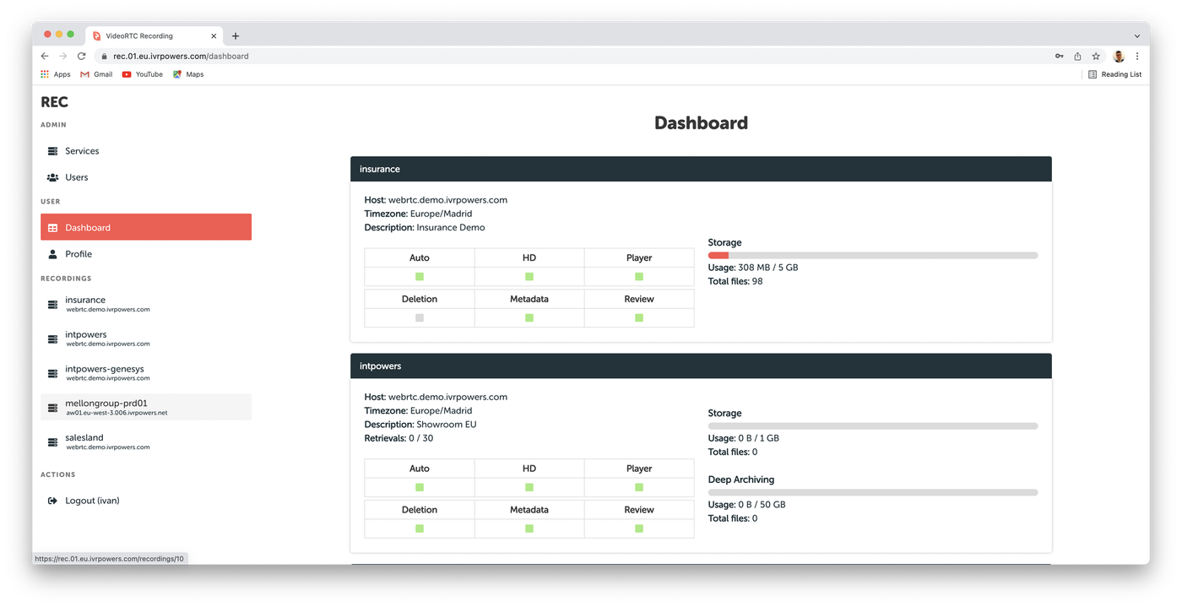
VIDEO REC
THE VIDEO STORAGE PLATFORM
Two storage tiers: fast access, then deep archive.
Main storage
Every recording lands in a regional S3 bucket, ready for playback.
Archive storage
Deep Archiving moves older recordings into low-cost Glacier vaults.
Your bucket, your keys
Recordings stay under your organisation’s own control.
02

Slide 3






THE GAP
Most recorders capture the screen. Not the face.
Video is now how contact centers meet regulated, high-trust customers face to face. The recording layer built for the audio era hasn't caught up.
Audio first, video an afterthought
AI investment absorbed by M&A
Compliance without the evidence
Compliance recorders add screen capture of the agent's desktop — not the live video interaction itself.
2025 saw the category consolidate sharply — Smarsh acquired CallCabinet, Thoma Bravo merged Verint with Calabrio.
A screen recording proves what an agent clicked. It doesn't prove what happened, face to face, on the call.
Video REC starts from the face, not the screen.
Purpose-built via the same SPLIT protocol that powers Video RTC, so what gets recorded is the live video interaction itself — not a bolt-on capture of somebody's desktop.
Positioning based on published capability pages of leading compliance-recording vendors, reviewed August 2026
The gap
2

Slide 4





THE PLATFORM
Built to record the interaction, not just the audio
Video REC is a reliable, scalable video call recording platform for contact centers, providing two levels of regional storage and long-term archiving with automatic post-processing — fully managed on AWS.
Native video capture
Multi-format output
Two-tier storage
Fully managed
Records live video contact-center interactions via the SPLIT protocol — not a screen-share bolt-on.
RAW, MP4 SD or MP4 HD, with automatic post-processing merging streams into one mixed file.
A fast-access bucket plus a deep-archive vault, so cost tracks how old — not how important — a recording is.
Unpacked, deployed and certified by the IntPowers team on AWS — no infrastructure of your own to run.
RAW → MP4
100GB–1TB
256-bit AES
Cloud-managed
SD / HD automatic post-processing
storage unit tiers
in transit & at rest
provisioned for you
Source: wiki.ivrpowers.com/en/videorec/start, /first-steps
The platform
3

Slide 5





DIFFERENTIATOR
What it means to actually record video, not just audio
Not screen capture with a compliance label on it. The live video interaction itself, archived under your own control.
Captures the face, not just the voice
Purpose-built with Video RTC
Your bucket, your keys
Native SPLIT-protocol video recording of the actual live interaction — not a bolted-on desktop capture.
Same protocol, same architecture, engineered together — not a third-party integration project.
Use your own S3 bucket and encryption keys — recordings stay under your organisation's control.
Transparent storage economics
Open to any analytics stack
Every review, logged
A published per-minute sizing table, not a black-box quote — see the worked example ahead.
Structured metadata exports to the speech-analytics vendor of your choice — no forced bundle.
Reviewed/QM status flags plus full user-activity audit logging, so the audit trail is as real as the recording.
The headline finding: of six compliance-recording vendors reviewed, none natively records webcam video as a first-class channel — all bolt on screen capture instead.
Source: wiki.ivrpowers.com/en/videorec/faq, competitor product pages reviewed August 2026
Differentiator
4

Slide 6
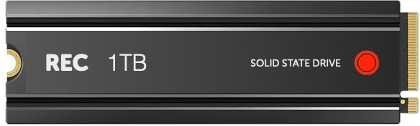


Did you know a Video Contact Center requires
special handling when processing its recordings?
Interactive Powers

Slide 7


FORMATS
Every call becomes RAW, then SD, then HD
RAW is the default output straight from the Video RTC gateway. Video REC's post-processing automatically merges the streams into a single mixed file, in the format your retention policy calls for.
RAW
MP4 SD
MP4 HD
Every stream, unmodified, straight from the gateway — the smallest footprint and the source of truth.
A standard-definition mixed file, merged and post-processed automatically after the call ends.
A high-definition mixed file for the clearest evidentiary, training and quality-review use.
Storage per minute of recorded video (published sizing table)
Duration
RAW only
RAW + SD
RAW + SD + HD
1 min
6 MB
8 MB
16 MB
15 min
100 MB
120 MB
240 MB
1 hour
390 MB
480 MB
950 MB
Source: wiki.ivrpowers.com/en/videorec/first-steps
Formats
5

Slide 8


STORAGE
Two storage tiers: fast access, then deep archive
A recording doesn't need the same storage tier on day one and day one thousand. Video REC moves it automatically.
Main storage — S3 bucket
Archive storage — Glacier vault
Every recording lands in a regional AWS S3 bucket first, ready for immediate search, review and playback.
Deep Archiving mode ('ARC') moves older recordings into low-cost, secure long-term cold storage automatically.
Use your own S3 bucket and your own security keys — recordings stay under your organisation's control, not pooled in shared multi-tenant storage.
Source: wiki.ivrpowers.com/en/videorec/start, /faq
Storage
6

Slide 9

STORAGE ECONOMICS
What a year of video recording actually costs to store
A worked example, published on the technical wiki — the kind of concrete sizing math most vendors keep behind a sales call.
100 calls/day
12 GB/day
240 GB/month
2.88 TB/year
15 min average, weekdays only, RAW + SD quality
1,500 minutes × 8 MB/minute
20 working days
one year of retention
Recommended: 3× Type 3 (1TB) storage units
Storage unit tiers: Type 1 = 100GB, Type 2 = 500GB, Type 3 = 1TB — sized to retention policy, not guessed.
This is one worked example, for illustration — your actual footprint depends on call volume, average duration and format mix. Ask your account team for a sizing worksheet against your traffic.
Source: wiki.ivrpowers.com/en/videorec/first-steps (worked sizing example)
Storage economics
7

Slide 10


METADATA & SEARCH
Every recording, tagged, searchable and in order
Custom metadata scripts
Search by any field
Sequence ordering
A script built for your deployment calls your ACD platform to fetch and attach call metadata automatically.
Filter and search recordings by custom metadata field, not just date and duration.
Recordings order by sequence number, so a multi-part interaction reads in the order it happened.
Search by metadata field shipped in v1.4.0 (2021); sequence-number ordering followed in v2.12.0 (2024) — steady, incremental investment in findability.
Source: wiki.ivrpowers.com/en/videorec/changelog (v1.4.0, v2.12.0)
Metadata & search
8

Slide 11
QUALITY MANAGEMENT
A review flag your quality team can actually trust
Advanced auditing manages the status flags, metadata and fields a QM team needs — a manual review workflow, done properly.
Reviewed status flags
Fields your team defines
Recordings can be marked Reviewed — and, distinctly, flagged "not approved" — so a QM team's judgement is captured alongside the file, not in a separate spreadsheet.
Status flags, metadata and required fields are configured for how your quality management process actually works — not a fixed, one-size scoring form.
Read precisely: this is a manual review and flagging workflow for your QM team, not an automated AI scoring engine — see the next slide for how automated analytics fits in.
Source: wiki.ivrpowers.com/en/videorec/changelog (v1.2.0, v1.4.0), Source: interactivepowers.com/en/platforms/videorec
Quality management
9

Slide 12


OPEN BY DESIGN
Open to any speech-analytics stack you choose
Video REC doesn't lock you into one analytics vendor's transcription and sentiment engine. It organises and exports what any of them need.
Structured metadata export
Best-of-breed, not bundled
Built for integration, not isolation
Your roadmap, your pace
Recordings and their metadata are organised for external speech-analytics systems to consume directly.
Plug in the transcription, sentiment or auto-QA vendor that fits your stack — not a forced single option.
The same metadata-script pattern used for ACD context works for feeding an analytics pipeline.
Add analytics when and where you need it, without waiting on a platform vendor's own AI release cycle.
Said plainly
Video REC does not run its own speech analytics, sentiment scoring or automated QA engine today — by design, it exports for the systems that do. If you already run one, or want to choose your own, that's a fit, not a gap.
Source: interactivepowers.com/en/platforms/videorec, Source: wiki.ivrpowers.com/en/videorec/changelog
Open by design
10

Slide 13



EXPORT
Where recordings go after the call ends
SFTP push
Custom scripts
CSV export
Retention & alerts
Custom post-processing scripts commonly push finished recordings to your own external servers securely.
Post-processing rules run after every recording, built around your export and retention requirements.
Bulk export of recording metadata to CSV, added v2.0.0, for reporting outside the platform.
Per-service, cron-scheduled deletion policies, with email and Slack alerts as storage nears capacity.
Example alert format: "Storage: 506 GB / 500 GB (101%)" — retention policies can differ by service (e.g. 100 days vs. 365 days), each on its own schedule.
Source: wiki.ivrpowers.com/en/videorec/extensions, /changelog (v2.0.0, v2.5.0, v2.13.0)
Export
11

Slide 14


ACCESS SECURITY
SSO, two-factor login and a full audit trail
SSO via SAML
OTP / two-factor login
Per-user IP allow-listing
Full audit logging
Signed AuthnRequests, encrypted assertions, full IdP/SP metadata configuration — added v2.14.0, May 2025.
One-time-password login added v2.9.0, August 2024, as a second factor on every sign-in.
Range-based allow-listing added v2.9.0, then extended to login, OTP and password-reset actions in v2.11.0.
User activity, IP addresses and blocked actions are all logged — a dedicated events reference is available on request.
Password recovery (v2.1.0, 2022) and a dedicated activity-log service (v2.7.0, 2024) rounded out the access-security build-out before SSO landed.
Source: wiki.ivrpowers.com/en/videorec/changelog (v2.1.0 – v2.14.0)
Access security
12

Slide 15



COMPLIANCE
Built on AWS's independently audited infrastructure
AWS-inherited certifications
256-bit encryption
24/7 monitoring
SOC 1, 2 & 3, ISO 27001 and FedRAMP/FISMA reports from AWS's own audited infrastructure underpin the platform.
AES/SSL encryption, no less than 256 bits, applied to data in transit and at rest.
A monitoring layer sits on top of AWS with daily manual log reviews, on top of AWS's own controls.
Customer-owned buckets & keys
Full audit logging
SSO, OTP and IP allow-listing
Bring your own S3 bucket and security keys, so storage stays governed by your own policy, not a shared pool.
Every user action, IP address and blocked attempt is logged, for a defensible operational record.
Layered access controls sit in front of the storage and playback layer, not just around the AWS account.
Read precisely: these certifications are AWS's own, inherited through the infrastructure Video REC runs on — not an independent audit of Video REC or IntPowers as a company.
Source: interactivepowers.com/en/platforms/videorec, interactivepowers.com/en/security-compliance
Compliance
13

Slide 16

DEPLOYMENT
Fully managed, so your team doesn't have to run it
Video REC is the one platform in the suite with no on-premises option — by design, not by omission. Here's the trade you get instead.
Provisioned by IntPowers
Containerized on AWS ECS
One thing to manage: policy
Unlike Smart IVR or Video RTC, this isn't a package you install — the IntPowers team unpacks, deploys and certifies every instance.
Processing, API and WebApp run as Docker containers on AWS, elastically scaled with call and storage demand.
You control per-service retention rules and your own encryption keys; IntPowers manages the infrastructure underneath.
Why cloud-only, here specifically
Video and storage workloads scale unevenly and benefit from elastic infrastructure — the two-tier bucket/vault model and automatic archiving depend on AWS S3 and Glacier specifically. What you keep control of is what matters most for compliance: your own bucket, your own keys, your own retention policy.
Source: wiki.ivrpowers.com/en/videorec/faq, /installation
Deployment
14

Slide 17
RELEASE TRACK
Four years of steady releases, one recording engine
Native video-call recording
Docker & CSV export
v2.3.0 · NOV 2022
v2.0.0 · APR 2022
Explicit "possibility to receive and process videocall recordings" added to the platform.
Processing, API and WebApp move to containerized deployment; bulk CSV export ships the same release.
Two-factor login & IP allow-listing
SSO arrives
v2.9.0 · AUG 2024
v2.14.0 · MAY 2025
OTP login and per-user IP allow-listing land together, tightening access to the recording archive.
SAML-based single sign-on, with signed requests and encrypted assertions — the most recent release.
Fifteen releases, one steady cadence
From first release (v1.0.0, March 2021) to the latest (v2.14.0, May 2025): 15 versions in roughly four years two months, about one every 3.4 months — steady, incremental hardening of storage, search, access control and auditing, release after release.
Source: wiki.ivrpowers.com/en/videorec/changelog (v1.0.0 – v2.14.0)
Release track
15

Slide 18



THE SUITE
Video REC is the compliance layer for three more products
Each platform stands alone and speaks standard protocols — but bought together they behave as one system, with no integration project in between.
Smart IVR
Web ACD
Video RTC
Video REC
AUTOMATION LAYER
DISTRIBUTION LAYER
MEDIA GATEWAY
RECORDING LAYER
Carrier-grade VoiceXML IVR with speech engines, handling the call before a human is needed.
Queues, routes and distributes voice and video to the right agent, and runs their desktop.
Hybrid SIP + WebRTC gateway for browsers, mobile devices and kiosks, built for high availability.
HD video recording, storage and archive, with export for analytics and compliance.
Video is the interaction. Record it like one — that's the thesis running through all four platforms, not just this one.
Cloud Services · hosting, monitoring and managed operation across all four platforms
Source: wiki.ivrpowers.com/en (platform documentation)
The suite
16

Slide 19
INTEROPERABILITY
Standards first, so it fits what you already run
Recording mechanism
Integration & export
Access & identity
Purpose-built for the Video RTC gateway's SPLIT protocol
Custom metadata scripts fetch context from your ACD platform
SSO via SAML, with signed requests and encrypted assertions
SPLIT Forward, Reverse and Scheduled communications supported
SFTP push and custom post-processing scripts for external systems
OTP two-factor login on every sign-in
Ready to connect with other contact-center solutions via the same protocol layer
CSV export for reporting outside the platform
Per-user IP allow-listing, including pre-login actions
Confirm production-proven third-party integrations with your account team
Structured metadata export for external speech-analytics systems
Full user-activity audit logging
Because recording rides the same SPLIT protocol as Video RTC, adding Video REC to a live deployment is a configuration step, not a migration.
Source: wiki.ivrpowers.com/en/videorec/faq, Source: wiki.ivrpowers.com/en/videorec/usage, /extensions
Interoperability
17

Slide 20
COMPARISON
Where Video REC parts company with audio-first recorders
A typical compliance recorder
Video REC
Video capture
Screen recording of the agent's desktop, an add-on tier
Native recording of the live video interaction itself
Analytics approach
Closed, built-in AI module, often behind a higher tier
Open export to the speech-analytics vendor of your choice
Storage model
Pooled, multi-tenant, vendor-controlled
Customer-owned S3 bucket and encryption keys
Storage sizing
Quote-based, opaque
Published per-minute table and worked example
Compliance posture
Independently held certifications (varies by vendor)
Built on AWS's independently audited infrastructure
Category dynamics
Consolidating fast — Smarsh/CallCabinet, Verint/Calabrio in 2025
Focused, video-native specialist inside one coherent suite
"A typical compliance recorder" summarises patterns published on the capability pages of NICE, Verint, CallCabinet (now Smarsh), Red Box, Uniphore and Calabrio, reviewed August 2026. Specific vendor comparisons available on request.
Comparison
18

Slide 21





IN PRODUCTION
Running where the evidence actually matters
Video REC operates as the recording layer for suite deployments across Latin America and Europe — where a recorded interaction is a compliance record, not just a training clip.
Atento
A consolidating category
A leading Spanish and Latin American customer experience provider implemented advanced video calling capabilities in their contact centers — enhancing customer interactions and improving resolution rates.
2025 saw Smarsh acquire CallCabinet and Thoma Bravo combine Verint with Calabrio — the big compliance-recording platforms are consolidating around scale. Video REC stays a focused, video-native specialist inside one suite.
Suite-level reference (video calling + recording) — confirm exact scope with your account team.
15 releases since March 2021 — steady investment through the consolidation wave.
Industries served (suite-wide client base)
Financial Services
Public Sector
Healthcare
Telecom & Utilities
BPO & Services
Named client references and quantified case-study results available under NDA through your account team.
Source: interactivepowers.com/en/success-cases; industry consolidation reviewed August 2026
In production
19

Slide 22
COMMERCIALS
Storage-tiered, not metered by the call
Video REC is provisioned as a managed service and sized to your storage footprint — not billed per minute or per agent seat.
Storage unit tiers
Managed end to end
Your keys, your control
Quote-based
Type 1 (100GB), Type 2 (500GB) or Type 3 (1TB) — sized to your retention policy, not your call volume.
IntPowers provisions, certifies and operates the service — no infrastructure project for your team to run.
Bring your own S3 bucket and encryption keys, and storage stays governed by your own security policy.
Sized against your actual retention and format mix — talk to sales for a worked estimate like the one in this brochure.
Why storage-tiered pricing is easier to plan around
Per-minute or per-seat recording fees are hard to forecast when video call volume is exactly what you're trying to grow. Sizing to a storage tier — backed by the published per-minute table two slides back — turns that into a line item you can actually budget.
Source: wiki.ivrpowers.com/en/videorec/first-steps (storage unit tiers)
Commercials
20

Slide 23
VIDEO REC · VIDEO CALL RECORDING
Record the whole
interaction. Prove it.
Let us show you a video call captured, stored and archived end to end — with a worked sizing estimate for your own traffic, and a clear answer on what's inherited and what's independently audited.
Talk to Sales
Request a Demo
interactivepowers.com

