Slide 1


PLATFORM · VIDEO CALL RECORDING
Video REC
Don't just hear it. See it. Prove it.
A reliable, scalable video call recording platform purpose-built for the suite's video-first contact centers — capturing, storing and archiving the whole face-to-face interaction, not just the audio.
RAW / SD / HD
S3 + Glacier
SSO · OTP
AWS-managed
multi-format capture
two-tier storage
access security
cloud service
2026 Product Brochure · Short edition

Slide 2
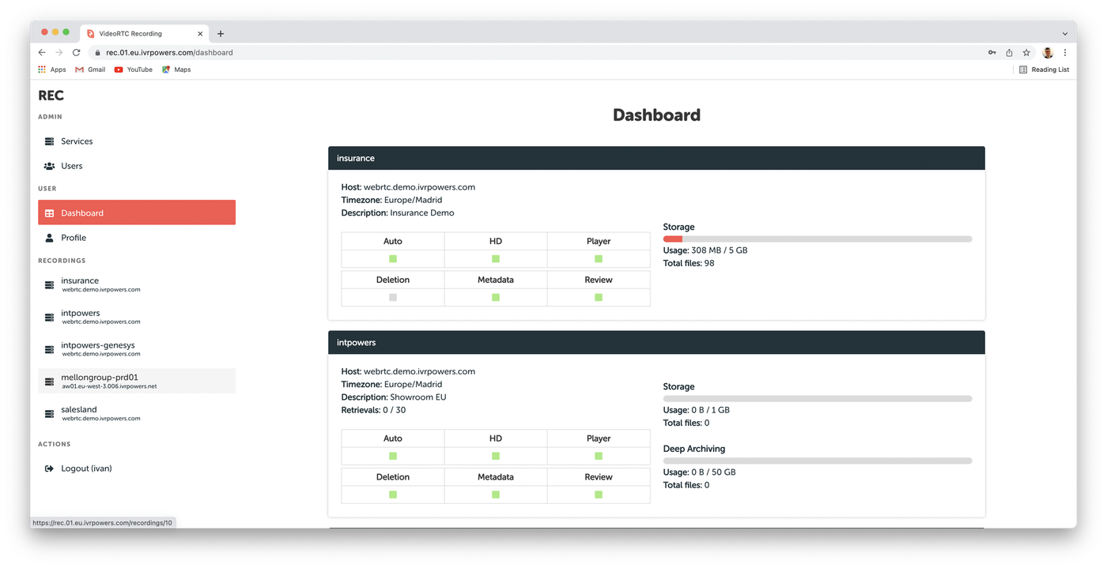
VIDEO REC
THE VIDEO STORAGE PLATFORM
Two storage tiers: fast access, then deep archive.
Main storage
Every recording lands in a regional S3 bucket, ready for playback.
Archive storage
Deep Archiving moves older recordings into low-cost Glacier vaults.
Your bucket, your keys
Recordings stay under your organisation’s own control.
02

Slide 3




THE GAP
Most recorders capture the screen. Not the face.
Video is now how contact centers meet regulated, high-trust customers face to face. The recording layer built for the audio era hasn't caught up.
Audio first, video an afterthought
AI investment absorbed by M&A
Compliance without the evidence
Video REC starts from the face, not the screen.
Purpose-built via the same SPLIT protocol that powers Video RTC, so what gets recorded is the live video interaction itself — not a bolt-on capture of somebody's desktop.
Native SPLIT-protocol video recording of the actual live interaction — not a bolted-on desktop capture.
Positioning based on published capability pages of leading compliance-recording vendors, reviewed August 2026
The gap
2

Slide 4





THE PLATFORM
Built to record the interaction, not just the audio
Video REC is a reliable, scalable video call recording platform for contact centers, providing two levels of regional storage and long-term archiving with automatic post-processing — fully managed on AWS.
Native video capture
Multi-format output
Two-tier storage
Fully managed
Records live video contact-center interactions via the SPLIT protocol — not a screen-share bolt-on.
RAW, MP4 SD or MP4 HD, with automatic post-processing merging streams into one mixed file.
A fast-access bucket plus a deep-archive vault, so cost tracks how old — not how important — a recording is.
Unpacked, deployed and certified by the IntPowers team on AWS — no infrastructure of your own to run.
RAW → MP4
100GB–1TB
256-bit AES
Cloud-managed
SD / HD automatic post-processing
storage unit tiers
in transit & at rest
provisioned for you
Source: wiki.ivrpowers.com/en/videorec/start, /first-steps
The platform
3

Slide 5





DIFFERENTIATOR
What it means to actually record video, not just audio
Not screen capture with a compliance label on it. The live video interaction itself, archived under your own control.
Captures the face, not just the voice
Purpose-built with Video RTC
Your bucket, your keys
Native SPLIT-protocol video recording of the actual live interaction — not a bolted-on desktop capture.
Same protocol, same architecture, engineered together — not a third-party integration project.
Use your own S3 bucket and encryption keys — recordings stay under your organisation's control.
Transparent storage economics
Open to any analytics stack
Every review, logged
A published per-minute sizing table, not a black-box quote — see the worked example ahead.
Structured metadata exports to the speech-analytics vendor of your choice — no forced bundle.
Reviewed/QM status flags plus full user-activity audit logging, so the audit trail is as real as the recording.
The headline finding: of six compliance-recording vendors reviewed, none natively records webcam video as a first-class channel — all bolt on screen capture instead.
Source: wiki.ivrpowers.com/en/videorec/faq, competitor product pages reviewed August 2026
Differentiator
4

Slide 6
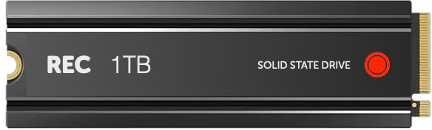


Did you know a Video Contact Center requires
special handling when processing its recordings?
Interactive Powers

Slide 7



CAPABILITIES
Metadata, review, export and access — one platform
Custom metadata scripts
Reviewed status flags
Structured metadata export
A script built for your deployment calls your ACD platform to fetch and attach call metadata automatically.
Recordings can be marked Reviewed — and, distinctly, flagged "not approved" — capturing a QM team's judgement with the file.
Recordings and their metadata are organised for external speech-analytics systems to consume directly.
SFTP push
SSO via SAML
AWS-inherited certifications
Custom post-processing scripts commonly push finished recordings to your own external servers securely.
Signed AuthnRequests, encrypted assertions, full IdP/SP metadata configuration — added v2.14.0, May 2025.
SOC 1, 2 & 3, ISO 27001 and FedRAMP/FISMA reports from AWS's own audited infrastructure underpin the platform.
Source: wiki.ivrpowers.com/en/videorec/changelog, Source: interactivepowers.com/en/platforms/videorec, Source: wiki.ivrpowers.com/en/videorec/extensions
Capabilities
5

Slide 8



THE SUITE
Video REC is the compliance layer for three more products
Each platform stands alone and speaks standard protocols — but bought together they behave as one system, with no integration project in between.
Smart IVR
Web ACD
Video RTC
Video REC
AUTOMATION LAYER
DISTRIBUTION LAYER
MEDIA GATEWAY
RECORDING LAYER
Carrier-grade VoiceXML IVR with speech engines, handling the call before a human is needed.
Queues, routes and distributes voice and video to the right agent, and runs their desktop.
Hybrid SIP + WebRTC gateway for browsers, mobile devices and kiosks, built for high availability.
HD video recording, storage and archive, with export for analytics and compliance.
Cloud Services · hosting, monitoring and managed operation across all four platforms
Source: wiki.ivrpowers.com/en (platform documentation)
The suite
6

Slide 9
COMPARISON
Where Video REC parts company with audio-first recorders
A typical compliance recorder
Video REC
Video capture
Screen recording of the agent's desktop, an add-on tier
Native recording of the live video interaction itself
Analytics approach
Closed, built-in AI module, often behind a higher tier
Open export to the speech-analytics vendor of your choice
Storage model
Pooled, multi-tenant, vendor-controlled
Customer-owned S3 bucket and encryption keys
Storage sizing
Quote-based, opaque
Published per-minute table and worked example
Compliance posture
Independently held certifications (varies by vendor)
Built on AWS's independently audited infrastructure
"A typical compliance recorder" summarises patterns published on the capability pages of NICE, Verint, CallCabinet (now Smarsh), Red Box, Uniphore and Calabrio, reviewed August 2026. Specific vendor comparisons available on request.
Comparison
7

Slide 10





IN PRODUCTION & COMMERCIALS
Running where the evidence matters, priced by storage
Industries served (suite-wide client base)
Financial Services
Public Sector
Healthcare
Telecom & Utilities
BPO & Services
Video REC operates as the recording layer for suite deployments across Latin America and Europe, including a suite-level reference at Atento — confirm exact scope with your account team. Named references available under NDA.
Storage-tiered, not metered by the call
Video REC is provisioned as a managed service and sized to a storage tier — Type 1 (100GB), Type 2 (500GB) or Type 3 (1TB) — not billed per minute or per agent seat. IntPowers provisions and operates the service on your own S3 bucket and encryption keys; pricing is quote-based, sized against your actual retention and format mix.
Per-minute or per-seat recording fees are hard to forecast when video call volume is exactly what you're trying to grow. Storage-tiered pricing turns that into a line item you can actually budget.
Source: interactivepowers.com/en/success-cases; Source: wiki.ivrpowers.com/en/videorec/first-steps
Proof & commercials
8

Slide 11
VIDEO REC · VIDEO CALL RECORDING
Record the whole
interaction. Prove it.
Let us show you a video call captured, stored and archived end to end — with a worked sizing estimate for your own traffic, and a clear answer on what's inherited and what's independently audited.
Talk to Sales
Request a Demo
interactivepowers.com

