Slide 1


PLATFORM · REAL-TIME VIDEO ENGINE
Video RTC
Real-time video, built into the core — not bolted on.
The SIP + WebRTC gateway that powers voice and video across the IntPowers suite — routed, recorded and reported like any other channel, deployed wherever your infrastructure has to live.
120–480
v6.0.0
Cloud / on-prem
10+ yrs
ports per server
current release, 2024
deployment
in production since 2016
2026 Product Brochure · Full edition

Slide 2
VIDEO RTC
THE VIDEO MEDIA PLATFORM
What agents and customers can do once video starts.
Screen sharing
Bidirectional, right alongside the live video feed.
Live chat & files
Text and file transfer run in parallel with video and voice.
Picture-in-Picture
Keep sight of the customer while you work in another app.
02

Slide 3





THE GAP
Everyone sells video APIs. Nobody builds it in.
CPaaS video vendors ship real-time media as a raw building block. Making it behave like a routed, supervised contact-center channel is left as an integration project — every time.
Generic building blocks
Cloud-only, no exceptions
Metered, unpredictable
Video arrives as raw SDK primitives — no queue, no skill-based routing, no agent desktop built in.
Of the leading CPaaS video vendors reviewed, none documents a true on-premise core media layer.
Pricing is per participant-minute, so cost scales — and surprises — with call volume, not headcount.
Video RTC starts from the contact center, not the API console.
It pairs a SIP + WebRTC hybrid gateway with SPLIT, a proprietary architecture that separates agent and client media purpose-built for routing — so video behaves like a channel from day one, on infrastructure you control.
Positioning based on published capability, deployment and pricing pages of leading CPaaS video vendors, reviewed August 2026
The gap
2

Slide 4






THE PLATFORM
A SIP + WebRTC gateway built for contact centers, not chat
Video RTC pairs a carrier-grade telephony engine for SIP/PSTN signalling with a dedicated WebRTC media gateway, so a video session is a first-class telephony object — not a separate app bolted next to the phone system. It installs as a package on Debian 12 LTS, on your own hardware, on a hypervisor, or on AWS.
Hybrid by architecture
Contact-center-native
Deploy anywhere
Open and interoperable
SIP and WebRTC meet in one gateway, so video can originate from a browser, a kiosk or a SIP endpoint alike.
The SPLIT protocol separates agent and client streams specifically for routing, not generic peer-to-peer chat.
Debian 12 LTS package runs on bare metal, VMware, Proxmox, KVM, Xen, or AWS / GCP / Azure / OVH — same build.
Documented guides for Genesys PureCloud and GoContact, plus generic SIP trunking to whatever you run today.
VP8 codec
120–480
TLS + SRTP
Per port
documented media codec
ports per server
signalling & media encryption
subscription or licence
Source: wiki.ivrpowers.com/en/videortc, /faq, /installation
The platform
3

Slide 5




DIFFERENTIATOR
The only gateway in its category with a real on-premise core
Not a hybrid meeting-app connector. The same media gateway, installed wherever your data is allowed to live.
Cloud
On-premises
Virtualized
Hybrid
AWS-hosted and managed option, across 5+ regions, with the operational model of a service.
A Debian 12 LTS package on your own hardware, inside your own network perimeter — nothing has to leave.
Certified for VMware, Proxmox, KVM and Xen, so it fits the virtualization estate you already operate.
Mix them — media gateway on-prem, control plane in the cloud, or the reverse, by jurisdiction.
Why it matters for video specifically
A recorded, transmitted face is biometric-adjacent personal data in most jurisdictions. Of the leading CPaaS video vendors reviewed in August 2026, none documents a true on-premise deployment of their core real-time media layer — the closest is a recording-only on-prem add-on from one vendor. A Debian package installed on infrastructure you control turns that gap into a checkbox.
Source: wiki.ivrpowers.com/en/videortc/faq, /videortc/installation
Differentiator
4

Slide 6
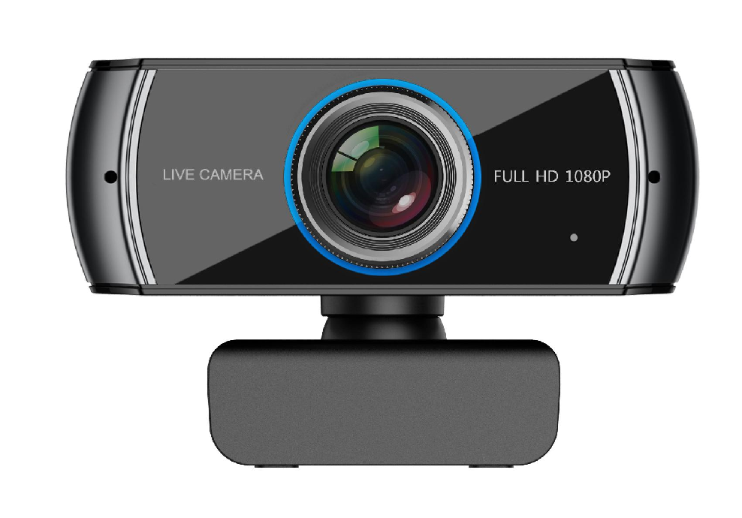









Did you know adding video calls to your Contact Center
can boost your agents' productivity?
Interactive Powers

Slide 7





ARCHITECTURE
What's actually inside the gateway
Protocol stack
SIP
WebRTC
Telephony engine
SRTP / DTLS
STUN
TLS
SPLIT architecture
Adaptive resolution
VP8 video codec
Separates agent and client media and data streams specifically for contact-center routing, not P2P chat.
Requested presets from QVGA up to 8K, negotiated per session against the bandwidth actually available.
The documented codec for media negotiation — broader codec parity is not publicly itemised in the docs.
STUN built in, TURN external
Encrypted transport
Multi-tenant accounts
STUN is configured on the gateway; TURN relays are supplied and configured per deployment, not bundled.
TLS secures signalling and SRTP / DTLS-SRTP secures media, end to end between browser and gateway.
One licensed gateway splits into multiple accounts, each with its own channel count and feature toggles.
Source: wiki.ivrpowers.com/en/videortc/faq, /videortc/configuration/core-system-settings
Architecture
5

Slide 8









USE CASES
One gateway, ten ways to start a video session
Webclient
SPLIT Agent
Remote Viewer
Video Room
Video Call
Full agent-facing web app: video, chat, file sharing and DTMF in one browser tab.
The contact-center use case — separates and routes agent/client media by design.
Screen-view collaboration alongside a live voice call, without switching channels.
P2P conferencing for up to 6 participants — team huddles or multi-party support.
Direct one-to-one peer video calling, browser to browser.
Video Mail
Video Player
Tester
SIP Client
Video ID
Asynchronous video messages for when a live session isn't possible.
Playback surface for recorded or shared video content inside the session.
A self-service WebRTC compatibility check before a session ever starts.
A software SIP endpoint for voice, alongside the video use cases.
Identity verification over live video, for onboarding and high-trust interactions.
Source: wiki.ivrpowers.com/en/videortc/use-cases, /extensions
Use cases
6

Slide 9






IN THE SESSION
What agents and customers can do once video starts
Screen sharing
Live chat & file sharing
Virtual backgrounds & blur
Bidirectional screen share in Chrome and Opera-family browsers, alongside the video feed.
Text chat and file transfer run in parallel with the video and voice stream.
MediaPipe-powered background blur and replacement, added to the SPLIT Agent use case.
Picture-in-Picture
Snapshot & QR join
Flip camera & devices
Pop the remote video into a floating window so agents keep sight of the customer while they work.
Capture a still frame mid-session, or hand a customer a QR code to join instantly from their phone.
Switch cameras and microphones mid-call without dropping the session.
Extensions add more: Web Panel Admin, Scheduler for time-limited links, and Tokenizer for token-gated rooms.
Source: wiki.ivrpowers.com/en/videortc/use-cases, /extensions, /changelog
In the session
7

Slide 10



RECORDING
Every session is capture-ready, out of the box
Video RTC doesn't just carry the session — it can capture it, then hand it off to the suite's compliance layer automatically.
Video RTC captures
Video REC stores & indexes
Native .mjr raw recording, toggled per account, inside the Videocall use case — added v5.2.0, October 2023.
Raw capture is transcoded to MP4 SD/HD, retained under policy, and available for compliance, quality and disputes.
One capture pipeline feeds one recording product — no third recorder to integrate, licence or reconcile with the media gateway.
Source: wiki.ivrpowers.com/en/videortc/changelog (v5.2.0), wiki.ivrpowers.com/en/videorec/first-steps
Recording
8

Slide 11





SECURITY
Encrypted by default, hardened by operations
TLS signalling
SRTP media
Perimeter hardening guidance
Every signalling connection between browser and gateway runs over TLS.
Media streams are protected with SRTP / DTLS-SRTP, end to end.
Documented practice: long passwords, disabled root SSH, VPN instead of exposed port-forwarding.
License-gated features
Patched, actively maintained
Deployment is a privacy control
Capacity and feature flags — recording, screen sharing, live chat — are enforced per licence, per account.
A ten-year release history includes real fixes, including two SCTP (usrsctp) library patches in 2020.
On-prem and virtualized installs keep video and signalling inside your own perimeter, by choice.
On-premises and virtualized installations keep signalling and media inside your own infrastructure — for regulated video, often the deciding factor.
Source: wiki.ivrpowers.com/en/videortc/troubleshooting, /first-steps
Security
9

Slide 12



SCALE
Capacity that grows with hardware, not a re-platform
120–480 ports per server
Load-balanced topology
Concurrent video sessions scale with the hardware and codecs configured on each node.
Multi-server and load-balancer configurations distribute media load across gateways.
Multi-tenant accounts
One engine, two dependents
Split one licensed gateway into multiple accounts, each with its own capacity and toggles.
Web ACD's video channel and Video REC's recordings both run on the same gateway capacity.
Built for AWS scale-out
Ten years of hardening
Packaged for deployment across AWS as well as private infrastructure and other public clouds.
A steady release cadence since 2016 — the core stack was proven under production load long before this decade's video boom.
Video quality adapts per session — from QVGA up through HD — according to the bandwidth actually available to each participant.
Source: wiki.ivrpowers.com/en/videortc/faq, /videortc/changelog
Scale
10

Slide 13



COMPATIBILITY
Runs where your customers already are
Full feature parity — audio, video, live chat, file sharing, DTMF, screen sharing, snapshot, Picture-in-Picture, QR code join — across five major browser engines.
Chrome
Edge
Firefox
Safari ≥12.1
Brave
Desktop browsers
Mobile browsers
Self-service kiosks
VideoRTC.js
Windows, macOS and Linux, wherever Chrome, Edge, Firefox, Safari or Brave run.
iOS and Android phones and tablets join from the native browser — no app store required.
Android, Linux and Windows kiosk deployments, per interactivepowers.com.
The client-side library (v4.3.0) ships reference implementations for every use case.
Source: wiki.ivrpowers.com/en/videortc/troubleshooting, interactivepowers.com (device coverage)
Compatibility
11

Slide 14


EXTENSIONS
Optional modules that extend the gateway
Configuration is file-based by default. These extensions add a management layer and customer-facing controls on top, without changing the core.
Web Panel / Admin
Back+
Scheduler
Tokenizer
A management UI for the gateway, beyond the file-based .jcfg configuration and service restarts.
Virtual background and blur effects for the SPLIT Agent use case, built on MediaPipe.
Time-limited, secure video appointment links issued to a customer and an agent.
Token-gated session links, so a video room is only reachable by whoever holds the link.
Source: wiki.ivrpowers.com/en/videortc/extensions
Extensions
12

Slide 15

RELEASE TRACK
Ten years of steady releases — recent highlights
Fullscreen & smarter rendering
Picture-in-Picture
v6.0.0 · JUL 2024
v5.2.0 · OCT 2023
browserEvents iframe API, fullscreen remote screen-share, and configurable video sizing across every use case.
PiP added to Webclient and SplitAgent, plus a recording toggle inside the Videocall use case.
Virtual backgrounds
Debian 11 core update
v5.1.0 · SEP 2022
v5.0.0 · JAN 2022
QR code join and MediaPipe-powered virtual background / blur added to the SPLIT Agent use case.
Platform core updated to Debian 11 and PHP 8.0, plus a Flip Camera action.
Under the hood, the same decade
Two usrsctp (SCTP) library vulnerabilities patched in 2020 · web stack modernised to Webpack / Vue / Bulma.io in 2019 · Safari support added in 2019 and later hardened for Safari 17.2+ fullscreen behaviour in 2024.
Source: wiki.ivrpowers.com/en/videortc/changelog (v1.0.0 – v6.0.0)
Release track
13

Slide 16


INTEROPERABILITY
Standards first, so it fits what you already run
Telephony
Contact-center platforms
Developer surface
Standard SIP trunking to any carrier or PBX
Documented, step-by-step guides for Genesys PureCloud and GoContact
VideoRTC.js client library, currently v4.3.0
Native core handles SIP / PSTN signalling
Corporate site lists 18+ CCaaS integrations, incl. Talkdesk, Cisco, Avaya, Zendesk, Five9, Twilio
Reference implementations for every use case
STUN built in; TURN configured per deployment
A generic integration guide for platforms without a dedicated walkthrough
File-based .jcfg configuration, service-level restarts
Licence-gated channel capacity, per account
SPLIT protocol purpose-built for agent/client separation
Multi-tenant "accounts" mode for per-project isolation
Because the gateway speaks standard SIP and WebRTC, Video RTC can be introduced next to an incumbent contact center and take on the video traffic first.
Source: wiki.ivrpowers.com/en/videortc/development/third-party-integrations, /development/videortcjs
Interoperability
14

Slide 17


THE SUITE
Video RTC is the media engine underneath three products
Each platform stands alone and speaks standard protocols — but bought together they behave as one system, with no integration project in between.
Smart IVR
Web ACD
Video RTC
Video REC
AUTOMATION LAYER
DISTRIBUTION LAYER
MEDIA GATEWAY
RECORDING LAYER
Carrier-grade VoiceXML IVR with speech engines, handling the call before a human is needed.
Queues, routes and distributes voice and video to the right agent, and runs their desktop.
Hybrid SIP + WebRTC gateway for browsers, mobile devices and kiosks, built for high availability.
HD video recording, storage and archive, with export for analytics and compliance.
Video RTC also interoperates directly with contact centers you already run — Genesys PureCloud and GoContact today — which is how many organisations add video to a suite they've already standardised on.
Cloud Services · hosting, monitoring and managed operation across all four platforms
Source: wiki.ivrpowers.com/en (platform documentation)
The suite
15

Slide 18


WHY VIDEO RTC
Four reasons this is a different kind of video vendor
Deployment freedom
Contact-center-native
Predictable licensing
One engine, whole suite
Cloud, on-prem or hybrid for the core media layer — a structurally rare deployment story in this category.
SPLIT was purpose-built to separate and route agent/client media, not adapted from generic video chat.
Per-port subscription plus maintenance — or a perpetual licence where needed — versus metered per-minute billing that spikes with volume.
The same media layer powers Web ACD's video channel and Video REC's recordings — one vendor, one architecture.
Twilio Video's own history makes the point
Twilio announced end-of-life for Programmable Video in December 2023, then reversed the decision in October 2024. Cloud-only video-API strategy carries platform risk that a self-hosted core does not.
Source: bloggeek.me, twilio.com/en-us/changelog, reviewed August 2026
Why Video RTC
16

Slide 19





SOLUTIONS
Every entry point runs on the same media engine
Remote Viewer
CoBrowsing
Web Caller
Field Service
Kiosk Manager
Collaboration on conventional telephone calls, adding a visual layer to a voice conversation already in progress.
Browse a website alongside the visitor during a chat, phone or video call, guiding rather than describing.
A browser-powered virtual phone embedded in any website, connected to your own telephony systems.
Fast video calling for professionals in the field who need to collaborate and get connected with users.
Self-service kiosks as a video entry point, with QR pairing, dynamic PIN and fleet management.
Every one of them is Video RTC underneath
A customer who starts on a website, in a mobile app, on a branch kiosk or from a field technician's phone is running on the same media gateway, the same encryption model and the same deployment options as the core Video RTC platform. The entry point changes; the engine underneath does not.
Source: interactivepowers.com/en (Solutions), wiki.ivrpowers.com/en
Solutions
17

Slide 20
COMPARISON
Where Video RTC parts company with CPaaS video APIs
A typical CPaaS video API
Video RTC
Core deployment
Cloud only, by architecture
Cloud, on-premises, virtualized or hybrid
Contact-center routing
Generic building block; integrate it yourself
Native SIP bridge with SPLIT for agent/client routing
Pricing model
Per-participant-minute, usage-metered
Subscription or licences
Where video data lives
The vendor's region, by architecture
Wherever you install the gateway
Compliance certifications
Named certs published by most large vendors
Not publicly documented for Video RTC today
Sales motion
Self-serve signup, free-minutes tier
Quote and POC-based, evaluation licence
"A typical CPaaS video API" summarises patterns published on the capability and pricing pages of Twilio Video, Vonage Video API, Agora, Daily.co, Zoom Video SDK and Amazon Chime SDK, reviewed August 2026. Specific vendor comparisons available on request.
Comparison
18

Slide 21





IN PRODUCTION
Running where the video actually matters
Video RTC carries voice and video traffic for banks, insurers, public agencies and utilities across Latin America and Europe — organisations for whom an interaction is a case file, not a ticket.
SNS24
OTIS Elevators
Banmédica
AFP Capital
SII
CDF
MAPFRE
Banco del Pacífico
AENA
BCI
"Video RTC is a great solution. Easily to implement, Multi-Channel, Secure and designed for Contact Center." — Javier S., Partner
Industries served
Financial Services
Public Sector
Healthcare
Industry & Utilities
BPO & Services
Suite-wide figures published by Interactive Powers (400K+ video calls/month, 300K+ recordings processed/month, 99.99% uptime, 5+ AWS regions) are not Video RTC-exclusive metrics. Named references available under NDA through your account team.
Source: interactivepowers.com/en/platforms/videortc (customer logos, stats)
In production
19

Slide 22





COMMERCIALS
Port-based subscription, with a licence available
Video RTC is contracted by subscription, per port — a port being one concurrent video session — on any deployment model. For the public sector and regulated environments that need to own the licence, we still offer a perpetual per-port purchase plus annual maintenance, quoted after a proof of concept — not a self-serve, metered API console.
Per-port subscription
Annual maintenance
Full-function evaluation
Quote and POC-based
Capacity-based pricing, quoted on release of the binary package — no public per-minute meter.
Covers new versions, updates and support — the upgrade path is included, not re-sold.
Complete, unrestricted functionality, with limited capacity and duration, for a proof of concept.
A slower first call than self-serve CPaaS signup, in exchange for predictable cost at scale.
What this means over a five-year horizon
Port-based subscription means you pay for simultaneous session capacity, not consumed minutes. Cost tracks actual business usage instead of spiking with adoption — with a predictable support line. And where your organization needs to own the licence, a perpetual per-port purchase is still available, with the same annual maintenance.
Source: wiki.ivrpowers.com/en/videortc/faq (licensing section)
Commercials
20

Slide 23
VIDEO RTC · REAL-TIME VIDEO ENGINE
Give your platform
a real video core.
Let us show you a session captured, routed and recorded end to end — on your own infrastructure if that's the requirement, with an evaluation licence and no capacity games.
Talk to Sales
Request a Demo
interactivepowers.com

