Slide 1


PLATFORM · REAL-TIME VIDEO ENGINE
Video RTC
Real-time video, built into the core — not bolted on.
The SIP + WebRTC gateway that powers voice and video across the IntPowers suite — routed, recorded and reported like any other channel, deployed wherever your infrastructure has to live.
120–480
v6.0.0
Cloud / on-prem
10+ yrs
ports per server
current release, 2024
deployment
in production since 2016
2026 Product Brochure · Short edition

Slide 2
VIDEO RTC
THE VIDEO MEDIA PLATFORM
What agents and customers can do once video starts.
Screen sharing
Bidirectional, right alongside the live video feed.
Live chat & files
Text and file transfer run in parallel with video and voice.
Picture-in-Picture
Keep sight of the customer while you work in another app.
02

Slide 3





THE GAP
Everyone sells video APIs. Nobody builds it in.
CPaaS video vendors ship real-time media as a raw building block. Making it behave like a routed, supervised contact-center channel is left as an integration project — every time.
Generic building blocks
Cloud-only, no exceptions
Metered, unpredictable
Video RTC starts from the contact center, not the API console.
It pairs a SIP + WebRTC hybrid gateway with SPLIT, a proprietary architecture that separates agent and client media purpose-built for routing — so video behaves like a channel from day one, on infrastructure you control.
Of the leading CPaaS video vendors reviewed, none documents a true on-premise core media layer — the closest is a recording-only on-prem add-on from one vendor.
Positioning based on published capability, deployment and pricing pages of leading CPaaS video vendors, reviewed August 2026
The gap
2

Slide 4






THE PLATFORM
A SIP + WebRTC gateway built for contact centers, not chat
Video RTC pairs a carrier-grade telephony engine for SIP/PSTN signalling with a dedicated WebRTC media gateway, so a video session is a first-class telephony object — not a separate app bolted next to the phone system. It installs as a package on Debian 12 LTS, on your own hardware, on a hypervisor, or on AWS.
Hybrid by architecture
Contact-center-native
Deploy anywhere
Open and interoperable
SIP and WebRTC meet in one gateway, so video can originate from a browser, a kiosk or a SIP endpoint alike.
The SPLIT protocol separates agent and client streams specifically for routing, not generic peer-to-peer chat.
Debian 12 LTS package runs on bare metal, VMware, Proxmox, KVM, Xen, or AWS / GCP / Azure / OVH — same build.
Documented guides for Genesys PureCloud and GoContact, plus generic SIP trunking to whatever you run today.
VP8 codec
120–480
TLS + SRTP
Per port
documented media codec
ports per server
signalling & media encryption
subscription or licence
Source: wiki.ivrpowers.com/en/videortc, /faq, /installation
The platform
3

Slide 5




DIFFERENTIATOR
The only gateway in its category with a real on-premise core
Not a hybrid meeting-app connector. The same media gateway, installed wherever your data is allowed to live.
Cloud
On-premises
Virtualized
Hybrid
AWS-hosted and managed option, across 5+ regions, with the operational model of a service.
A Debian 12 LTS package on your own hardware, inside your own network perimeter — nothing has to leave.
Certified for VMware, Proxmox, KVM and Xen, so it fits the virtualization estate you already operate.
Mix them — media gateway on-prem, control plane in the cloud, or the reverse, by jurisdiction.
Why it matters for video specifically
A recorded, transmitted face is biometric-adjacent personal data in most jurisdictions. Of the leading CPaaS video vendors reviewed in August 2026, none documents a true on-premise deployment of their core real-time media layer. A Debian package installed on infrastructure you control turns that gap into a checkbox.
Source: wiki.ivrpowers.com/en/videortc/faq, /videortc/installation
Differentiator
4

Slide 6
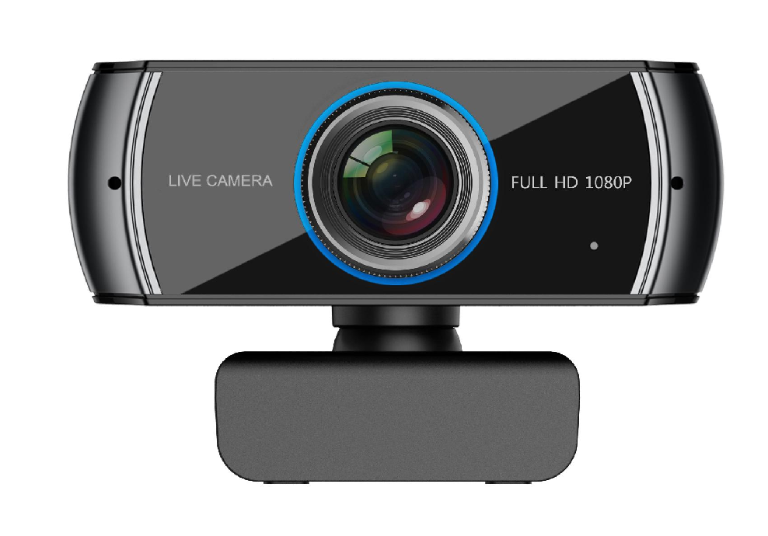









Did you know adding video calls to your Contact Center
can boost your agents' productivity?
Interactive Powers

Slide 7





CAPABILITIES
Architecture, in-session tools and security — one gateway
SPLIT architecture
SPLIT Agent use case
Screen sharing
Separates agent and client media and data streams specifically for contact-center routing, not P2P chat.
The contact-center use case — separates and routes agent/client media by design.
Bidirectional screen share in Chrome and Opera-family browsers, alongside the video feed.
Picture-in-Picture
Encrypted transport
Perimeter hardening guidance
Pop the remote video into a floating window so agents keep sight of the customer while they work.
TLS secures signalling and SRTP / DTLS-SRTP secures media, end to end between browser and gateway.
Documented practice: long passwords, disabled root SSH, VPN instead of exposed port-forwarding.
Source: wiki.ivrpowers.com/en/videortc/use-cases, /extensions, /troubleshooting
Capabilities
5

Slide 8



THE SUITE
Video RTC is the media engine underneath three products
Each platform stands alone and speaks standard protocols — but bought together they behave as one system, with no integration project in between.
Smart IVR
Web ACD
Video RTC
Video REC
AUTOMATION LAYER
DISTRIBUTION LAYER
MEDIA GATEWAY
RECORDING LAYER
Carrier-grade VoiceXML IVR with speech engines, handling the call before a human is needed.
Queues, routes and distributes voice and video to the right agent, and runs their desktop.
Hybrid SIP + WebRTC gateway for browsers, mobile devices and kiosks, built for high availability.
HD video recording, storage and archive, with export for analytics and compliance.
Cloud Services · hosting, monitoring and managed operation across all four platforms
Source: wiki.ivrpowers.com/en (platform documentation)
The suite
6

Slide 9
COMPARISON
Where Video RTC parts company with CPaaS video APIs
A typical CPaaS video API
Video RTC
Core deployment
Cloud only, by architecture
Cloud, on-premises, virtualized or hybrid
Contact-center routing
Generic building block; integrate it yourself
Native SIP bridge with SPLIT for agent/client routing
Pricing model
Per-participant-minute, usage-metered
Subscription or licences
Compliance certifications
Named certs published by most large vendors
Not publicly documented for Video RTC today
Sales motion
Self-serve signup, free-minutes tier
Quote and POC-based, evaluation licence
"A typical CPaaS video API" summarises patterns published on the capability and pricing pages of Twilio Video, Vonage Video API, Agora, Daily.co, Zoom Video SDK and Amazon Chime SDK, reviewed August 2026. Specific vendor comparisons available on request.
Comparison
7

Slide 10
IN PRODUCTION & COMMERCIALS
Running where it matters, licensed to keep it that way
Selected clients
SNS24
OTIS Elevators
Banmédica
AFP Capital
SII
Video RTC carries voice and video traffic for banks, insurers, public agencies and utilities across Latin America and Europe. Named references available under NDA through your account team.
Port-based subscription, with a licence available
Video RTC is contracted by subscription, per port — a port being one concurrent video session — on any deployment model. For the public sector and regulated environments that need to own the licence, we still offer a perpetual per-port purchase plus annual maintenance, quoted after a proof of concept. Full-function evaluation licences are available for a proof of concept.
Port-based subscription means you pay for simultaneous session capacity, not consumed minutes. Cost tracks actual business usage instead of rising with adoption — and a perpetual per-port purchase is still available for organizations that need to own the licence.
Source: interactivepowers.com/en/platforms/videortc; Source: wiki.ivrpowers.com/en/videortc/faq (licensing section)
Proof & commercials
8

Slide 11
VIDEO RTC · REAL-TIME VIDEO ENGINE
Give your platform
a real video core.
Let us show you a session captured, routed and recorded end to end — on your own infrastructure if that's the requirement, with an evaluation licence and no capacity games.
Talk to Sales
Request a Demo
interactivepowers.com

