Slide 1


PLATFORM · VIDEO-CENTRIC ACD
Web ACD
Video is a channel, not an add-on.
The convergent voice and video ACD for contact centers that meet their customers face to face — routed, supervised, recorded and reported by one platform, deployed wherever your data has to live.
19
3
SD–4K
Cloud / on-prem
locales
user roles
adaptive video
deployment
2026 Product Brochure · Full edition

Slide 2
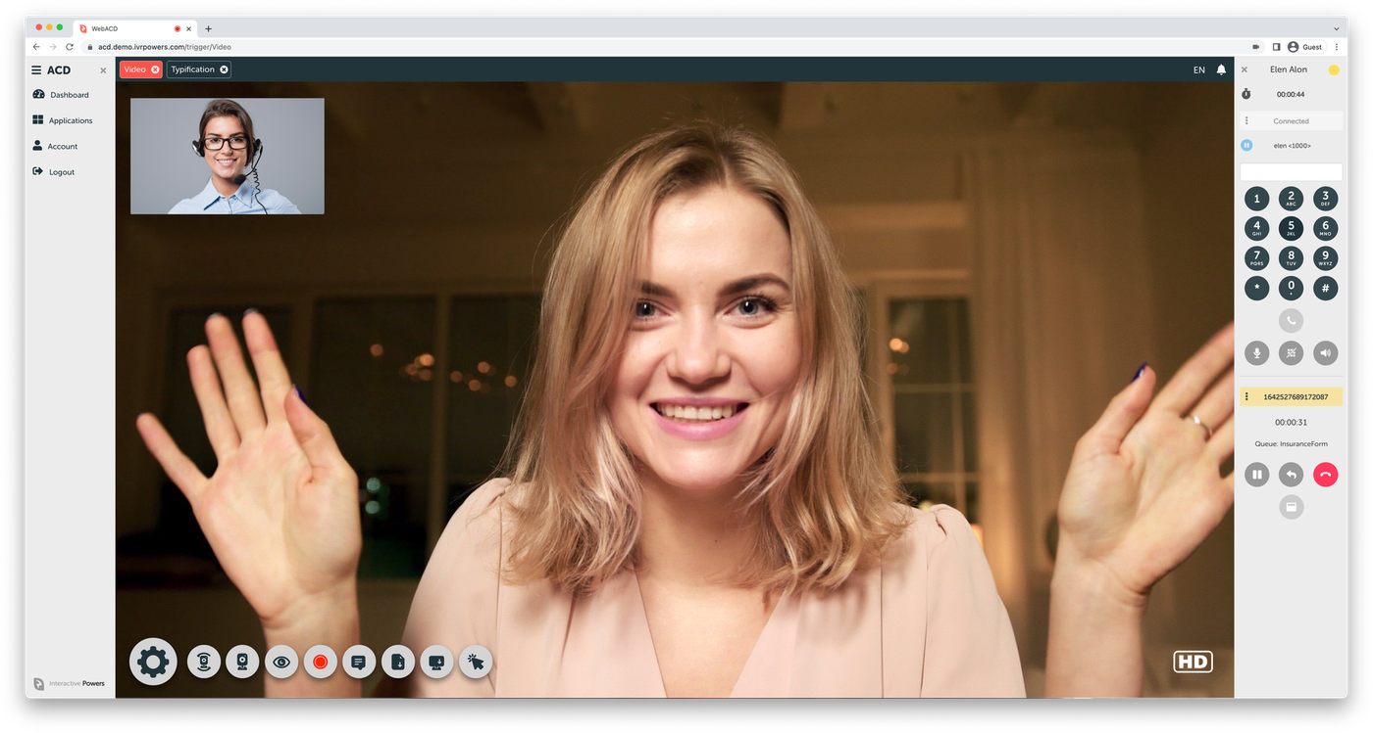
WEB ACD
THE SMART ROUTING PLATFORM
The distributor at the centre of the platform.
Queued and skilled
Video calls enter the same queues and rules as voice.
Supervised live
Monitor video interactions from the same panel as voice.
Recorded and archived
Native integration with Video REC for every call.
02

Slide 3





THE GAP
Everyone says omnichannel. Almost nobody routes video.
Contact center platforms have spent a decade adding channels — chat, email, SMS, social, messaging apps. Video is the one channel that keeps getting treated as an exception.
Missing from the channel list
Priced as a paid add-on
Delegated to a third party
Video simply does not appear among the routable interaction types, so there is nothing to queue, staff or report on.
Video exists, but outside the bundle — metered separately, which quietly discourages the teams who would use it most.
Video arrives through a marketplace plug-in, with its own console, its own recording and its own support path.
Web ACD starts from the other end.
It was built as a video-centric agent desktop with an automatic call distributor inside it — so a video call is queued, skilled, transferred, supervised, recorded and reported exactly like a phone call, on the same platform, in the same licence.
Positioning based on published capability and pricing pages of leading CCaaS suites, reviewed August 2026
The gap
2

Slide 4






THE PLATFORM
A web-responsive business phone with an ACD inside
Web ACD is a software-based, 100% packaged platform that turns any modern browser into a full contact center endpoint. It supports WebRTC natively, connects to existing contact centers over standard SIP, and runs on Linux Debian 64-bit — on your own servers, on a virtual machine, or on AWS.
Convergent by architecture
Video-centric by design
Deploy anywhere
Open and interoperable
One interface, one queue engine and one report set for phone calls and video calls alike.
The desktop was laid out around the video pane first, not retrofitted around a softphone.
Cloud, on-premises or virtualized — the same build, so data residency is a choice, not a constraint.
Standard SIP trunking, WebRTC browsers, and SPLIT for hybrid RTC connectivity to platforms you already run.
256-bit
Hundreds
19 locales
Seat-based
AES / SSL encryption
of agents per instance
EN · ES · PT · HU
subscription or licence
Source: wiki.ivrpowers.com/en/webacd, /faq
The platform
3

Slide 5






DIFFERENTIATOR
What it means for video to be a real channel
Not a meeting link sent from a chat window. A video interaction that the distributor owns end to end.
Queued and skilled
Transferable
Supervised live
Video calls enter the same queues, with the same distribution strategies and agent assignment rules as voice.
A video call can be transferred to another service, extension or agent — including to a plain phone extension.
Supervisors monitor video interactions in real time from the same panel they use for voice.
Recorded and archived
Adaptive quality
Measured after the call
Native integration with Video REC captures HD video for quality, compliance and dispute resolution.
Video adapts from LD through SD and HD to Ultra HD according to the bandwidth actually available.
Post-video-call events trigger automatic surveys, so video gets its own satisfaction data — not a blended average.
Entry points: any WebRTC-compliant browser, iOS and Android devices, and self-service kiosks.
Source: wiki.ivrpowers.com/en/webacd/faq, /videortc
Differentiator
4

Slide 6


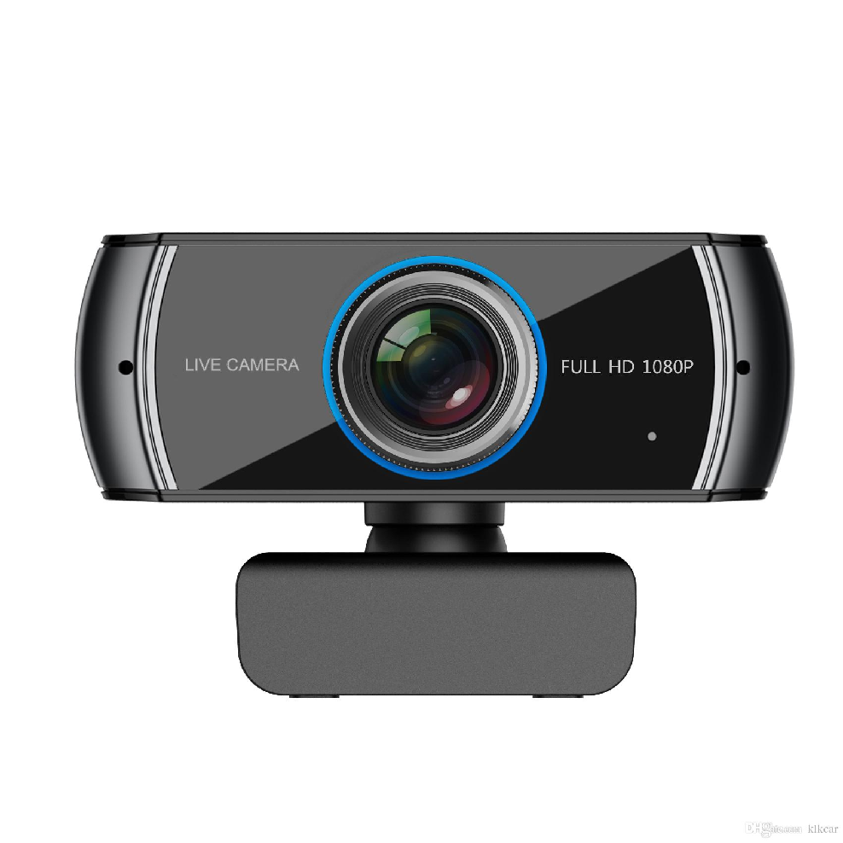







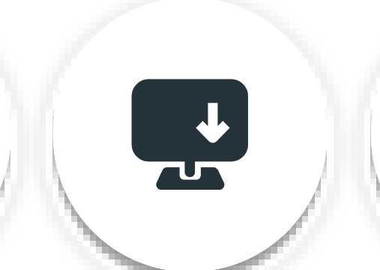

TURNKEY
START
Did you know you can transform teamwork
and your processes with new tools?
Interactive Powers

Slide 7




ROUTING
The distributor at the centre of the platform
Queue distribution strategies
Round Robin
Random
Simultaneous
Time Based
Talk Time
Queues and routes
Dynamic agent assignment
Pause management
Build inbound and outbound flows with dedicated queue and route objects, each independently configurable.
Adding or removing an agent from a queue updates membership automatically, with visual feedback in the panel.
Standard and custom pause types, pause timers, auto-pause per queue, and pause state preserved across reconnects.
Triggers on call events
Transfers and blending
Auto-answer
Queue triggers fire on call events and can open an app in an iframe or a new tab, auto-closing at call end.
Inter-user transfers from a queue, agent-to-agent transfer, plus inbound and outbound campaign handling.
SIP users can auto-answer with an audible beep, removing the pickup delay on high-volume queues.
Source: wiki.ivrpowers.com/en/webacd/faq, /webacd/configuration, /webacd/changelog
Routing
5

Slide 8






AGENT EXPERIENCE
A desktop built around the conversation
Agents work in a single browser workspace: the video pane and phone controls on one side, the applications your business runs on the other. Nothing to install, nothing to alt-tab between.
Full softphone
Personal statistics
Dialpad with key tones, DTMF during calls, and ringing tone between extensions.
Each agent has a page for their own daily activity — calls, pauses and connected time.
Call history
Embedded applications
A call history button on the phone and a Latest Calls view for the working day.
Business apps open inside the desktop or in a new tab, passing user and name variables.
OS notifications
Requirements check
Incoming call notifications surface even when the web app is in the background.
A built-in check verifies microphone, speaker and browser support before the shift starts.
Touch and mobile ready
Dark Mode
Sleep-mode prevention on touch devices and a responsive layout for tablets and phones.
A full dark interface for low-light rooms and long or late shifts.
Source: wiki.ivrpowers.com/en/webacd/changelog, /webacd/usage
Agent experience
6

Slide 9




SUPERVISION
Real-time control, with permissions that fit the team
Live queue monitoring
Whisper, listen and transfer
Broadcast to agents
A real-time Queues panel with per-queue statistics, agent status and talking indicators, refreshed over websockets.
Coach an agent mid-call, listen in for quality, or move an interaction without dropping the customer.
Send a supervision message to the whole floor or direct it to specific agents during a peak.
Graded permissions
Attention thresholds
Full roster visibility
Supervisors can be granted a narrower scope — queue listing, editing a subset of queue parameters, or agent management.
A maximum attention time parameter per queue makes service-level breaches visible as they happen.
Show offline users in the dashboard to see the whole team, not only who happens to be connected.
Source: wiki.ivrpowers.com/en/webacd/changelog, /webacd/usage
Supervision
7

Slide 10




ANALYTICS
Reporting your business intelligence team can actually use
Web ACD ships with a library of default reports and lets administrators write and save their own queries. Report generation runs on a separate worker, so heavy extractions never compete with live call handling.
Default report library
Custom reports
A batch of ready-made reports covering calls, agents and pauses is installed with the platform.
Define, preview and manage your own report queries from the administration interface.
CDR as the source of truth
Remote database mode
Call detail records, including the typified user field, are the base for every extraction.
The reporting worker can read from a remote database, keeping analytical load off the production node.
Export to BI and speech analytics
Real-time counters
Any report can be exported for downstream business intelligence or speech analytics processing.
Connected time and agent status are available in minutes for live service-level tracking.
Source: wiki.ivrpowers.com/en/webacd/changelog, /webacd/configuration
Analytics
8

Slide 11



ADMINISTRATION
Five configuration domains, one console
Staff
Voice
Analytics
Platform
System
User profiles for administrators, supervisors and agents; status panel; supervisor permission sets.
Queues, routes, pauses and SIP trunks, each with full lifecycle management and live trunk status.
The default report catalogue plus creation, configuration and deletion of custom reports.
Network, media and SMTP settings, plus custom parameters for the deployment.
Lower-level parameters, licence status and a system summary of the running instance.
Extensibility built into the administration layer
Custom PHP modules
WebSocket API
Database custom modules
extend platform behaviour without forking the product
query the full user roster and drive real-time actions
read business data mid-call for screen-pop and typification
Source: wiki.ivrpowers.com/en/webacd/configuration, /changelog
Administration
9

Slide 12



APPLICATIONS
Extend the desktop without leaving it
Applications run inside the agent workspace and receive call context automatically, so the agent never retypes what the platform already knows.
Scheduler
Recorder
Messenger
Book video appointments and issue time-limited secure links to customers and agents.
List, filter, play and download call recordings by call ID or date range from a secure panel.
Private XMPP chat between agents and supervisors, alongside the live conversation.
Typifier
Home Screen
Back+
Capture structured outcome data during or after a call, written to the CDR user field.
Put your brand and key service information on the agent's landing screen.
Immersive background effects — blur, corporate imagery or an office scene — for video calls.
Applications open embedded or in a new tab, and can receive user, name and destination variables from the queue trigger.
Source: wiki.ivrpowers.com/en/webacd/extensions, interactivepowers.com
Applications
10

Slide 13



RELEASE TRACK
What changed in 2025 and 2026
Progressive Web App
Two-factor authentication
v1.25 · MAY 2026
v1.26 · JUL 2026
Install Web ACD as an app on the desktop or home screen, with faster start-up and no browser chrome.
Email OTP as a second factor on every login, for agents, supervisors and administrators alike.
Hungarian language
WebRTC warm-up
v1.23 · NOV 2025
v1.23.1 · DEC 2025
hu_HU joins the platform, bringing coverage to 19 locales across English, Spanish, Portuguese and Hungarian.
Microphone permission is requested at connection, eliminating audio faults on an agent's first call of the day.
Under the hood, the same period
Node.js runtime moved to 18 LTS and libraries updated · a database connection bottleneck that could block the application removed · query race conditions resolved · dark-theme table styles and layout heights corrected · WSS transport templates extended with local and external IP handling.
Source: wiki.ivrpowers.com/en/webacd/changelog (v1.22.0 – v1.26.0)
Release track
11

Slide 14





SECURITY
Protection at the session, the account and the perimeter
Encrypted in transit
Two-factor authentication
Role-based access control
256-bit AES encryption over SSL-certified transport for signalling and media alike.
Email OTP verification on login, applied uniformly across all three user roles.
Administrator, supervisor and agent roles, with supervisor scope narrowed permission by permission.
Recording under your control
Auditable operations
Perimeter of your choosing
Recordings are held by your Video REC instance, in the environment and jurisdiction you chose.
CDR, agent and pause records give a reconstructable history of who handled what, and when.
Run it inside your own network, and no interaction data has to cross an external boundary at all.
Deployment choice is a privacy control: on-premises and virtualized installations keep conversation content, recordings and reporting data inside your own infrastructure.
Source: interactivepowers.com/en/platforms/webacd, /webacd/changelog
Security
12

Slide 15

DEPLOYMENT
The same platform, wherever it has to run
Most contact center platforms sold today exist in exactly one place: the vendor's cloud. Web ACD does not force that choice.
Cloud
On-premises
Virtualized
Hybrid
Hosted and managed on AWS, with the operational model of a service and no infrastructure of your own to run.
Packaged for Linux Debian 64-bit on your own hardware, inside your own network perimeter.
Licensed for Amazon EC2, VMware, Proxmox and Xen, so it fits the virtualization estate you already operate.
Combine them — for instance, agents in the cloud with recording and archive retained on your premises.
Why it matters for video specifically
Video is the heaviest, most personal and most regulated payload a contact center handles — a recorded face is biometric-adjacent personal data in most jurisdictions. Being able to keep video capture, storage and archive inside your own perimeter turns the hardest objection in a banking, healthcare, insurance or public-sector procurement into a configuration decision.
Source: wiki.ivrpowers.com/en/webacd/faq (installation, hosting and licensing sections)
Deployment
13

Slide 16





SCALE
Engineered to grow without re-platforming
Hundreds of agents per instance
Resilient sessions
Concurrency depends on the codecs and processes enabled, and scales with the resources you give it.
A five-minute reconnection grace period preserves agent state, and disconnect dialogs surface socket loss immediately.
Load-balanced video
Separated workloads
Video services distribute across Video RTC gateways, so media capacity grows independently of the ACD.
Report generation runs on its own worker and can target a remote database, isolating analytics from live traffic.
Built for AWS scale-out
Pooled database access
Designed, built and packaged for deployment in AWS cloud environments as well as private infrastructure.
Connection pooling replaced single-connection access, removing a bottleneck under sustained concurrency.
Video quality adapts per session — LD, SD, HD or Ultra HD — according to the IP bandwidth actually available to each participant.
Source: wiki.ivrpowers.com/en/webacd/faq, /webacd/changelog
Scale
14

Slide 17



THE SUITE
Web ACD is one layer of a complete stack
Each platform stands alone and speaks standard protocols — but bought together they behave as one system, with no integration project in between.
Smart IVR
Web ACD
Video RTC
Video REC
AUTOMATION LAYER
DISTRIBUTION LAYER
MEDIA GATEWAY
RECORDING LAYER
Carrier-grade VoiceXML IVR with speech engines, handling the call before a human is needed.
Queues, routes and distributes voice and video to the right agent, and runs their desktop.
Hybrid SIP + WebRTC gateway for browsers, mobile devices and kiosks, built for high availability.
HD video recording, storage and archive, with export for analytics and compliance.
Video RTC is designed to interoperate with existing contact center and CCaaS platforms as well — which is how many organisations add video to a suite they have already standardised on.
Cloud Services · hosting, monitoring and managed operation across all four platforms
Source: wiki.ivrpowers.com/en (platform documentation)
The suite
15

Slide 18



AUTOMATION
Self-service and speech AI, from the same stack
Automation in a Web ACD deployment is delivered by Smart IVR, the suite's carrier-grade IVR platform — so the bot and the agent share one telephony layer, one set of trunks and one reporting trail.
Speech engines
Conversational mode
VoiceXML 2.x
Carrier-grade concurrency
Support for advanced TTS, STT, ASR and NLU engines, so you choose the vendor that fits your language and budget.
Run touch-tone prompts and speech-recognition scripting, then switch to natural-language conversation.
Built on an open W3C standard with extended tags, keeping applications portable rather than vendor-locked.
Multi-tenancy with hundreds of simultaneous calls per server for automated phone applications.
Automation and live agents on one continuum
A caller can be identified and served by a voicebot, then escalated to a queued video call with a named agent — without changing platform, losing context or crossing a vendor boundary mid-conversation.
Source: wiki.ivrpowers.com/en/smartivr
Automation
16

Slide 19





SOLUTIONS
Purpose-built engagement tools on top of the platform
Remote Viewer
CoBrowsing
Web Caller
Field Service
Kiosk Manager
Collaboration on conventional telephone calls, adding a visual layer to a voice conversation already in progress.
Browse a website alongside the visitor during a chat, phone or video call, guiding rather than describing.
A browser-powered virtual phone embedded in any website, connected to your own telephony systems.
Fast video calling for professionals in the field who need to collaborate and get connected with users.
Self-service kiosks as a video entry point, with QR pairing, dynamic PIN and fleet management.
Every one of them is a way into the same queue
A customer who starts on a website, in a mobile app, on a branch kiosk or from a field technician's phone arrives in the same Web ACD queue, is distributed by the same strategy, is supervised in the same panel and appears in the same report. The entry point changes; the operating model does not.
Source: interactivepowers.com/en (Solutions), wiki.ivrpowers.com/en
Solutions
17

Slide 20

INTEROPERABILITY
Standards first, so it fits what you already run
Telephony
Applications
Platform APIs
Standard SIP trunking to any carrier or VoIP system
Business apps embedded in the desktop or opened in a tab
Custom PHP modules to extend platform functionality
SPLIT — hybrid SIP + WebRTC protocol for RTC trunking
Call data passed by destination into custom applications
WebSocket actions for real-time roster and messaging
Connects to existing contact centers rather than replacing them
User and name variables available to apps and queue triggers
Database custom modules for mid-call business lookups
Trunk configuration and live trunk status in the console
Queue triggers with copy and QR-code actions
Reporting worker able to target a remote database
Because the platform speaks standard SIP and WebRTC, Web ACD can be introduced next to an incumbent contact center and take on the video traffic first.
Source: wiki.ivrpowers.com/en/webacd/faq, /webacd/changelog, /webacd/configuration
Interoperability
18

Slide 21
COMPARISON
Where Web ACD parts company with the suites
A typical CCaaS suite
Web ACD
Video as a channel
Absent, add-on priced, or a marketplace plug-in
Native, routed by the same ACD as voice
Video recording
Usually a separate product or partner
Video REC, integrated in the same suite
Deployment
Vendor cloud only, in most cases
Cloud, on-premises, virtualized or hybrid
Where video data lives
The vendor's region, by architecture
Wherever you install it
Commercial model
Per agent, per month, indefinitely
Subscription or licences
Vendors in the stack
Platform, plus video partner, plus recorder
One vendor for IVR, ACD, video and recording
"A typical CCaaS suite" summarises patterns published on the capability and pricing pages of leading platforms as of August 2026. Specific vendor comparisons available on request.
Comparison
19

Slide 22






IN PRODUCTION
Running where the conversation actually matters
Web ACD is deployed in public services, healthcare, insurance and financial institutions across Latin America and Europe — sectors where an interaction is a case file, not a ticket.
Industries served
Financial Services
Public Sector
Healthcare
Telecom & Utilities
BPO & Services
Named customer references, with deployment size and outcome detail, are available under NDA through your account team.
Source: interactivepowers.com/en/platforms/webacd (customer logos)
In production
20

Slide 23





COMMERCIALS
Seat-based subscription, with a licence available
Web ACD is contracted by subscription, by seat — a seat being one agent, supervisor or administrator — on any deployment model. For the public sector and regulated environments that need to own the licence, we still offer a perpetual per-seat purchase, with an annual maintenance that covers new versions, updates and online support.
Seat-based subscription
Annual maintenance
Full-function evaluation
Email and phone support
Units are seats by role, so the commercial model matches the way the contact center is actually staffed.
Covers new versions, updates and online support — the upgrade path is included, not re-sold.
Complete, unrestricted functionality, with limited capacity and duration, for a proof of concept.
Delivered according to your licence maintenance, from teams covering CET and EST business hours.
What this means over a five-year horizon
Seat-based subscription means you pay for contact center capacity, not a named licence tied to each person. Cost tracks how the contact center is actually staffed — and video is inside it, not metered on top. And where your organization needs to own the licence, a perpetual per-seat purchase is still available, with the same annual maintenance.
Source: wiki.ivrpowers.com/en/webacd/faq (licensing and billing section)
Commercials
21

Slide 24
WEB ACD · VIDEO-CENTRIC ACD
Put a face to your
contact center.
Let us show you a queued video call — distributed, supervised, recorded and reported — on your own use case, with an evaluation licence and no capacity games.
Talk to Sales
Request a Demo
interactivepowers.com

