Slide 1


PLATFORM · VIDEO-CENTRIC ACD
Web ACD
Video is a channel, not an add-on.
The convergent voice and video ACD for contact centers that meet their customers face to face — routed, supervised, recorded and reported by one platform, deployed wherever your data has to live.
19
3
SD–4K
Cloud / on-prem
locales
user roles
adaptive video
deployment
2026 Product Brochure · Short edition

Slide 2
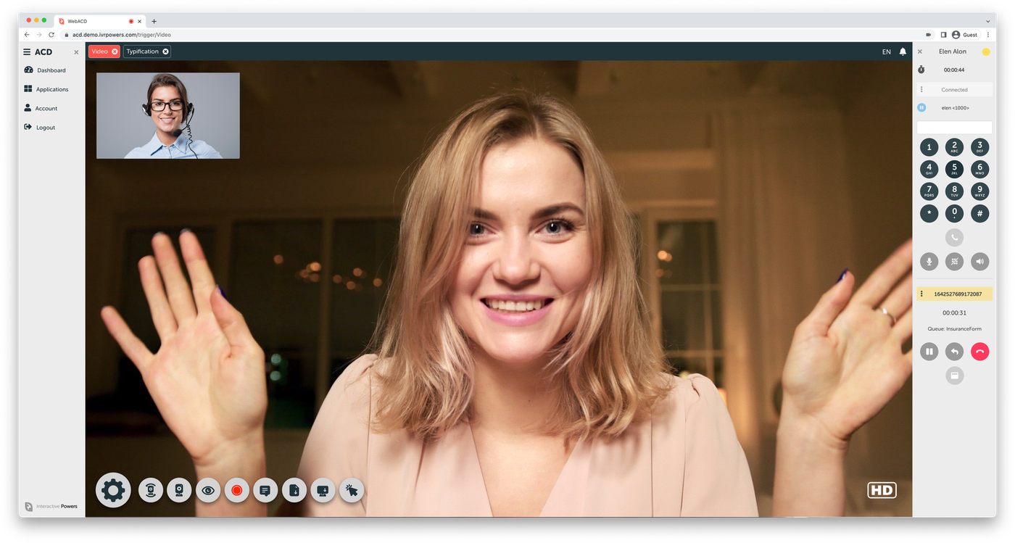
WEB ACD
THE SMART ROUTING PLATFORM
The distributor at the centre of the platform.
Queued and skilled
Video calls enter the same queues and rules as voice.
Supervised live
Monitor video interactions from the same panel as voice.
Recorded and archived
Native integration with Video REC for every call.
02

Slide 3




THE GAP
Everyone says omnichannel. Almost nobody routes video.
Contact center platforms have spent a decade adding channels — chat, email, SMS, social, messaging apps. Video is the one channel that keeps getting treated as an exception.
Missing from the channel list
Priced as a paid add-on
Delegated to a third party
Web ACD starts from the other end.
It was built as a video-centric agent desktop with an automatic call distributor inside it — so a video call is queued, skilled, transferred, supervised, recorded and reported exactly like a phone call, on the same platform, in the same licence.
Native video capture, adaptive from LD through SD and HD to Ultra HD, entering the same queues and reported alongside every phone call — not bolted on from a third-party meeting link.
Positioning based on published capability and pricing pages of leading CCaaS suites, reviewed August 2026
The gap
2

Slide 4






THE PLATFORM
A web-responsive business phone with an ACD inside
Web ACD is a software-based, 100% packaged platform that turns any modern browser into a full contact center endpoint. It supports WebRTC natively, connects to existing contact centers over standard SIP, and runs on Linux Debian 64-bit — on your own servers, on a virtual machine, or on AWS.
Convergent by architecture
Video-centric by design
Deploy anywhere
Open and interoperable
One interface, one queue engine and one report set for phone calls and video calls alike.
The desktop was laid out around the video pane first, not retrofitted around a softphone.
Cloud, on-premises or virtualized — the same build, so data residency is a choice, not a constraint.
Standard SIP trunking, WebRTC browsers, and SPLIT for hybrid RTC connectivity to platforms you already run.
256-bit
Hundreds
19 locales
Seat-based
AES / SSL encryption
of agents per instance
EN · ES · PT · HU
subscription or licence
Source: wiki.ivrpowers.com/en/webacd, /faq
The platform
3

Slide 5






DIFFERENTIATOR
What it means for video to be a real channel
Not a meeting link sent from a chat window. A video interaction that the distributor owns end to end.
Queued and skilled
Transferable
Supervised live
Video calls enter the same queues, with the same distribution strategies and agent assignment rules as voice.
A video call can be transferred to another service, extension or agent — including to a plain phone extension.
Supervisors monitor video interactions in real time from the same panel they use for voice.
Recorded and archived
Adaptive quality
Measured after the call
Native integration with Video REC captures HD video for quality, compliance and dispute resolution.
Video adapts from LD through SD and HD to Ultra HD according to the bandwidth actually available.
Post-video-call events trigger automatic surveys, so video gets its own satisfaction data — not a blended average.
Entry points: any WebRTC-compliant browser, iOS and Android devices, and self-service kiosks.
Source: wiki.ivrpowers.com/en/webacd/faq, /videortc
Differentiator
4

Slide 6


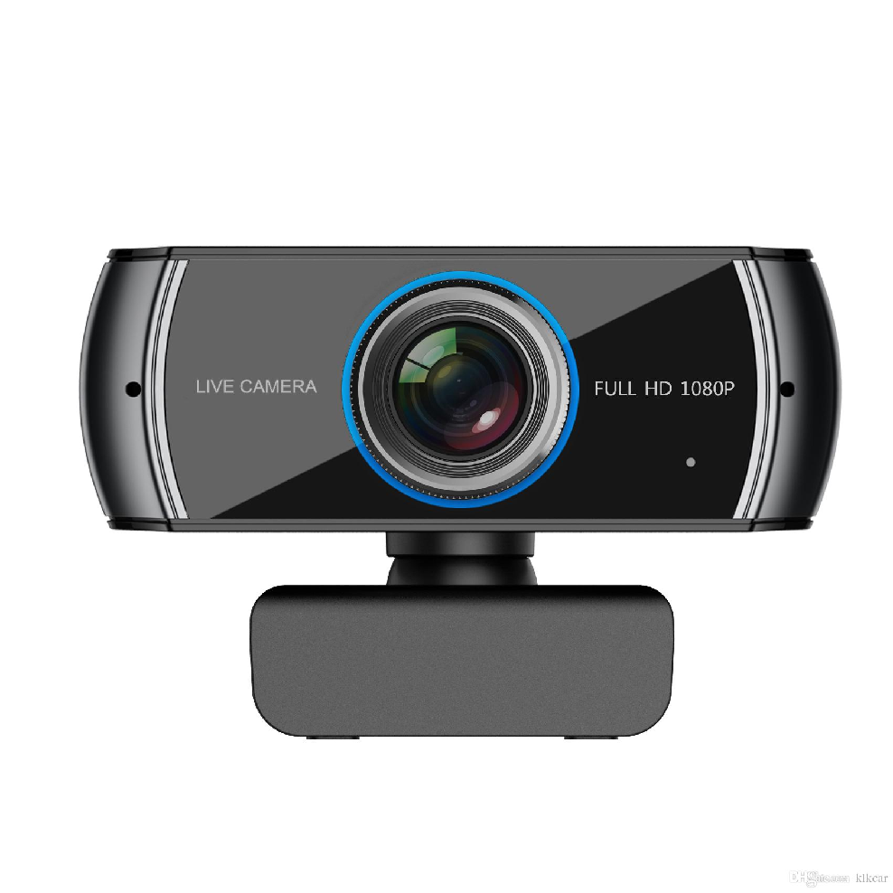









TURNKEY
START
Did you know you can transform teamwork
and your processes with new tools?
Interactive Powers

Slide 7





CAPABILITIES
Routing, agents, supervision and security — one console
Queues and routes
Full softphone
Live queue monitoring
Build inbound and outbound flows with dedicated queue and route objects, each independently configurable.
Dialpad with key tones, DTMF during calls, and ringing tone between extensions.
A real-time Queues panel with per-queue statistics, agent status and talking indicators.
Whisper, listen and transfer
Default report library
Role-based access control
Coach an agent mid-call, listen in for quality, or move an interaction without dropping the customer.
A batch of ready-made reports covering calls, agents and pauses is installed with the platform.
Administrator, supervisor and agent roles, with supervisor scope narrowed permission by permission.
Source: wiki.ivrpowers.com/en/webacd/faq, /webacd/configuration, /webacd/changelog
Capabilities
5

Slide 8



THE SUITE
Web ACD is one layer of a complete stack
Each platform stands alone and speaks standard protocols — but bought together they behave as one system, with no integration project in between.
Smart IVR
Web ACD
Video RTC
Video REC
AUTOMATION LAYER
DISTRIBUTION LAYER
MEDIA GATEWAY
RECORDING LAYER
Carrier-grade VoiceXML IVR with speech engines, handling the call before a human is needed.
Queues, routes and distributes voice and video to the right agent, and runs their desktop.
Hybrid SIP + WebRTC gateway for browsers, mobile devices and kiosks, built for high availability.
HD video recording, storage and archive, with export for analytics and compliance.
Cloud Services · hosting, monitoring and managed operation across all four platforms
Source: wiki.ivrpowers.com/en (platform documentation)
The suite
6

Slide 9
COMPARISON
Where Web ACD parts company with the suites
A typical CCaaS suite
Web ACD
Video as a channel
Absent, add-on priced, or a marketplace plug-in
Native, routed by the same ACD as voice
Video recording
Usually a separate product or partner
Video REC, integrated in the same suite
Deployment
Vendor cloud only, in most cases
Cloud, on-premises, virtualized or hybrid
Commercial model
Per agent, per month, indefinitely
Subscription or licences
Vendors in the stack
Platform, plus video partner, plus recorder
One vendor for IVR, ACD, video and recording
"A typical CCaaS suite" summarises patterns published on the capability and pricing pages of leading platforms as of August 2026. Specific vendor comparisons available on request.
Comparison
7

Slide 10





IN PRODUCTION & COMMERCIALS
Running where it matters, licensed to keep it that way
Industries served
Financial Services
Public Sector
Healthcare
Telecom & Utilities
BPO & Services
Deployed in public services, healthcare, insurance and financial institutions across Latin America and Europe. Named references available under NDA through your account team.
Seat-based subscription, with a licence available
Web ACD is contracted by subscription, by seat — a seat being one agent, supervisor or administrator. For the public sector and regulated environments that need to own the licence, we still offer a perpetual per-seat purchase, with an annual maintenance that covers new versions, updates and online support. Full-function evaluation licences are available for a proof of concept.
Seat-based subscription means you pay for contact center capacity, not a named licence tied to each person. Cost tracks how the contact center is actually staffed, and video is inside it — and a perpetual per-seat purchase is still available for organizations that need to own the licence.
Source: interactivepowers.com/en/platforms/webacd; Source: wiki.ivrpowers.com/en/webacd/faq (licensing and billing section)
Proof & commercials
8

Slide 11
WEB ACD · VIDEO-CENTRIC ACD
Put a face to your
contact center.
Let us show you a queued video call — distributed, supervised, recorded and reported — on your own use case, with an evaluation licence and no capacity games.
Talk to Sales
Request a Demo
interactivepowers.com

