Slide 1
Telepresencia HUMANA
Interactive Powers

Slide 2
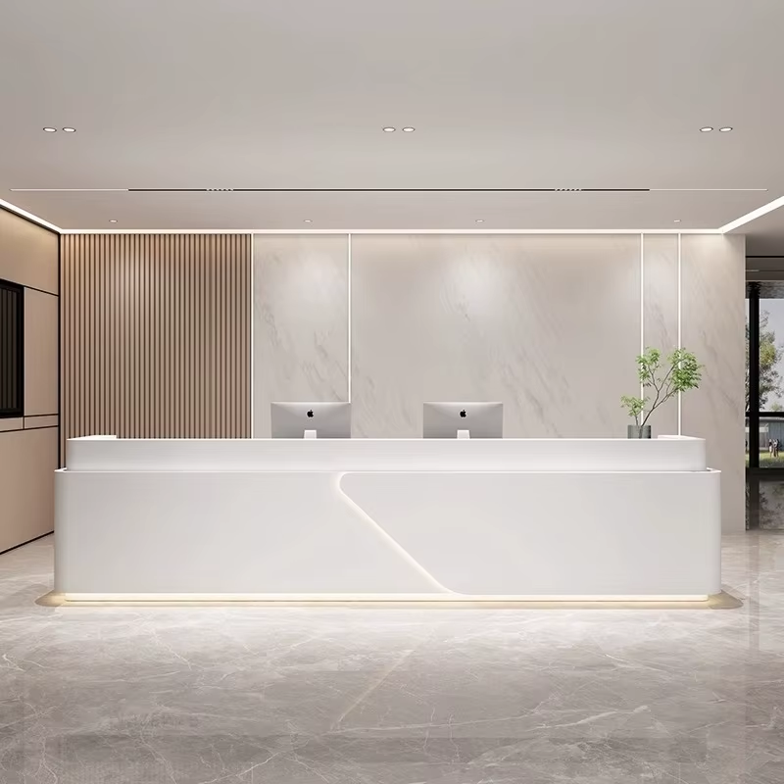


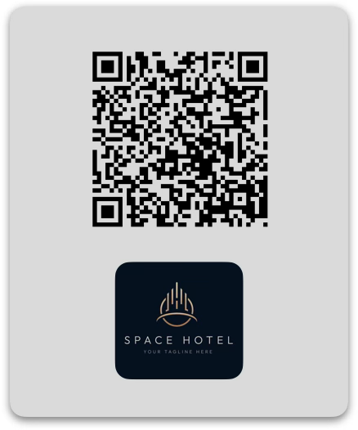

Slide 3
1
Video Kiosco
Video Tableta
Sticker QR
1
Video Kiosco

Slide 4
2
Video Tableta
Video Tableta
Sticker QR
2
Video Kiosco

Slide 5
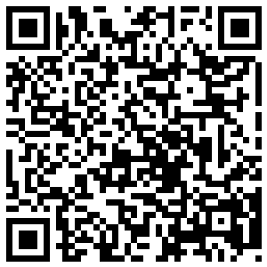
3
Sticker QR
Video Tableta
Sticker QR
Concierge - 3112
3
Scan to start a video call, or speak directly with the first available concierge, and manage service requests in real time, 24/7. Add this PWA icon to your phone to reconnect anytime with your room number or Platinum partner ID.
Video Kiosco

Slide 6
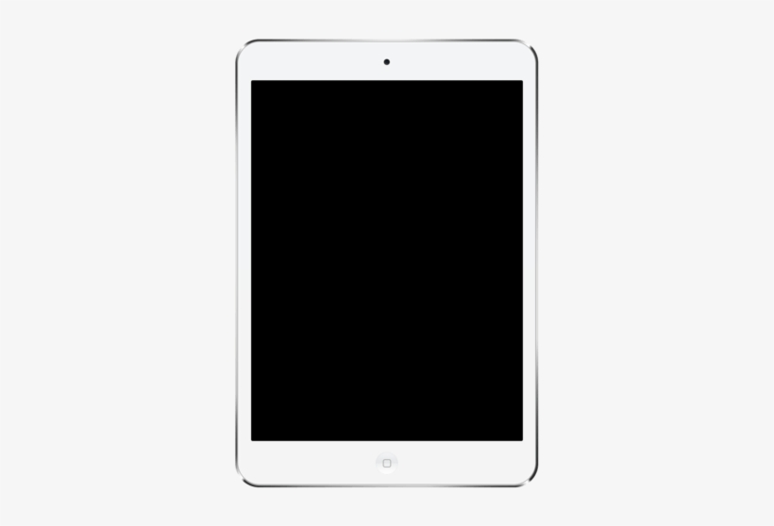

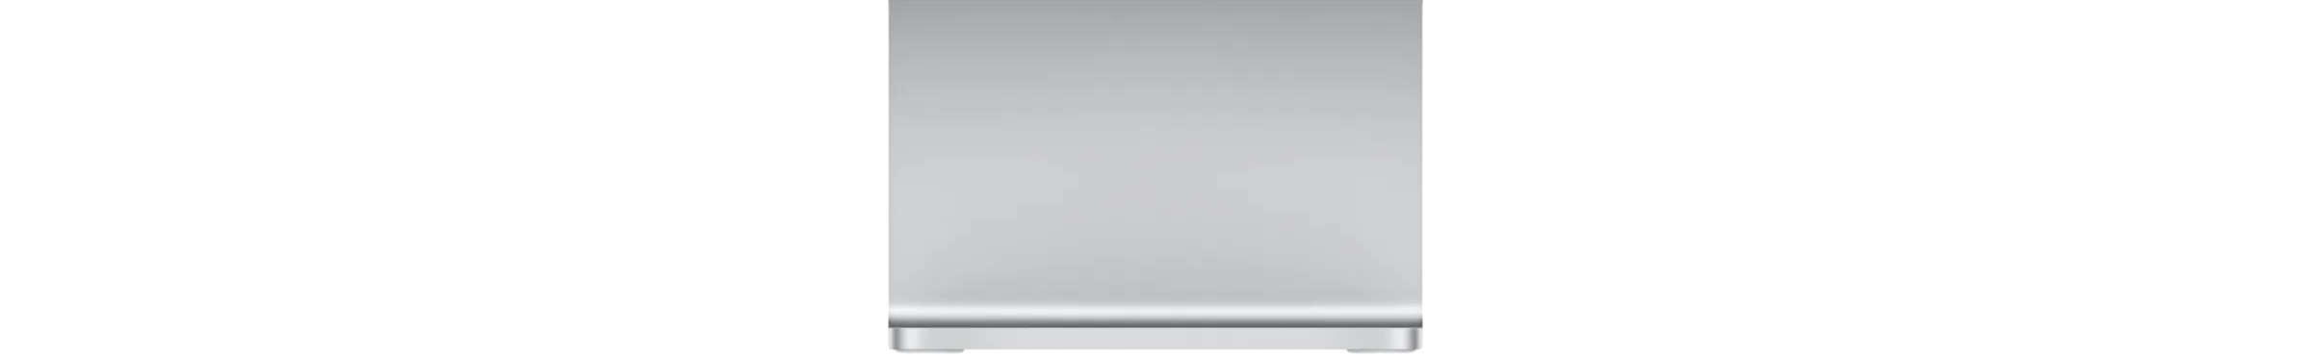
Dispositivos Phygital
Pantalla o Video Kiosco
Tableta iPad o Android
Sticker QR

Slide 7
Kiosco 3212
Sticker QR 3212
Sticker QR 3212

Slide 8


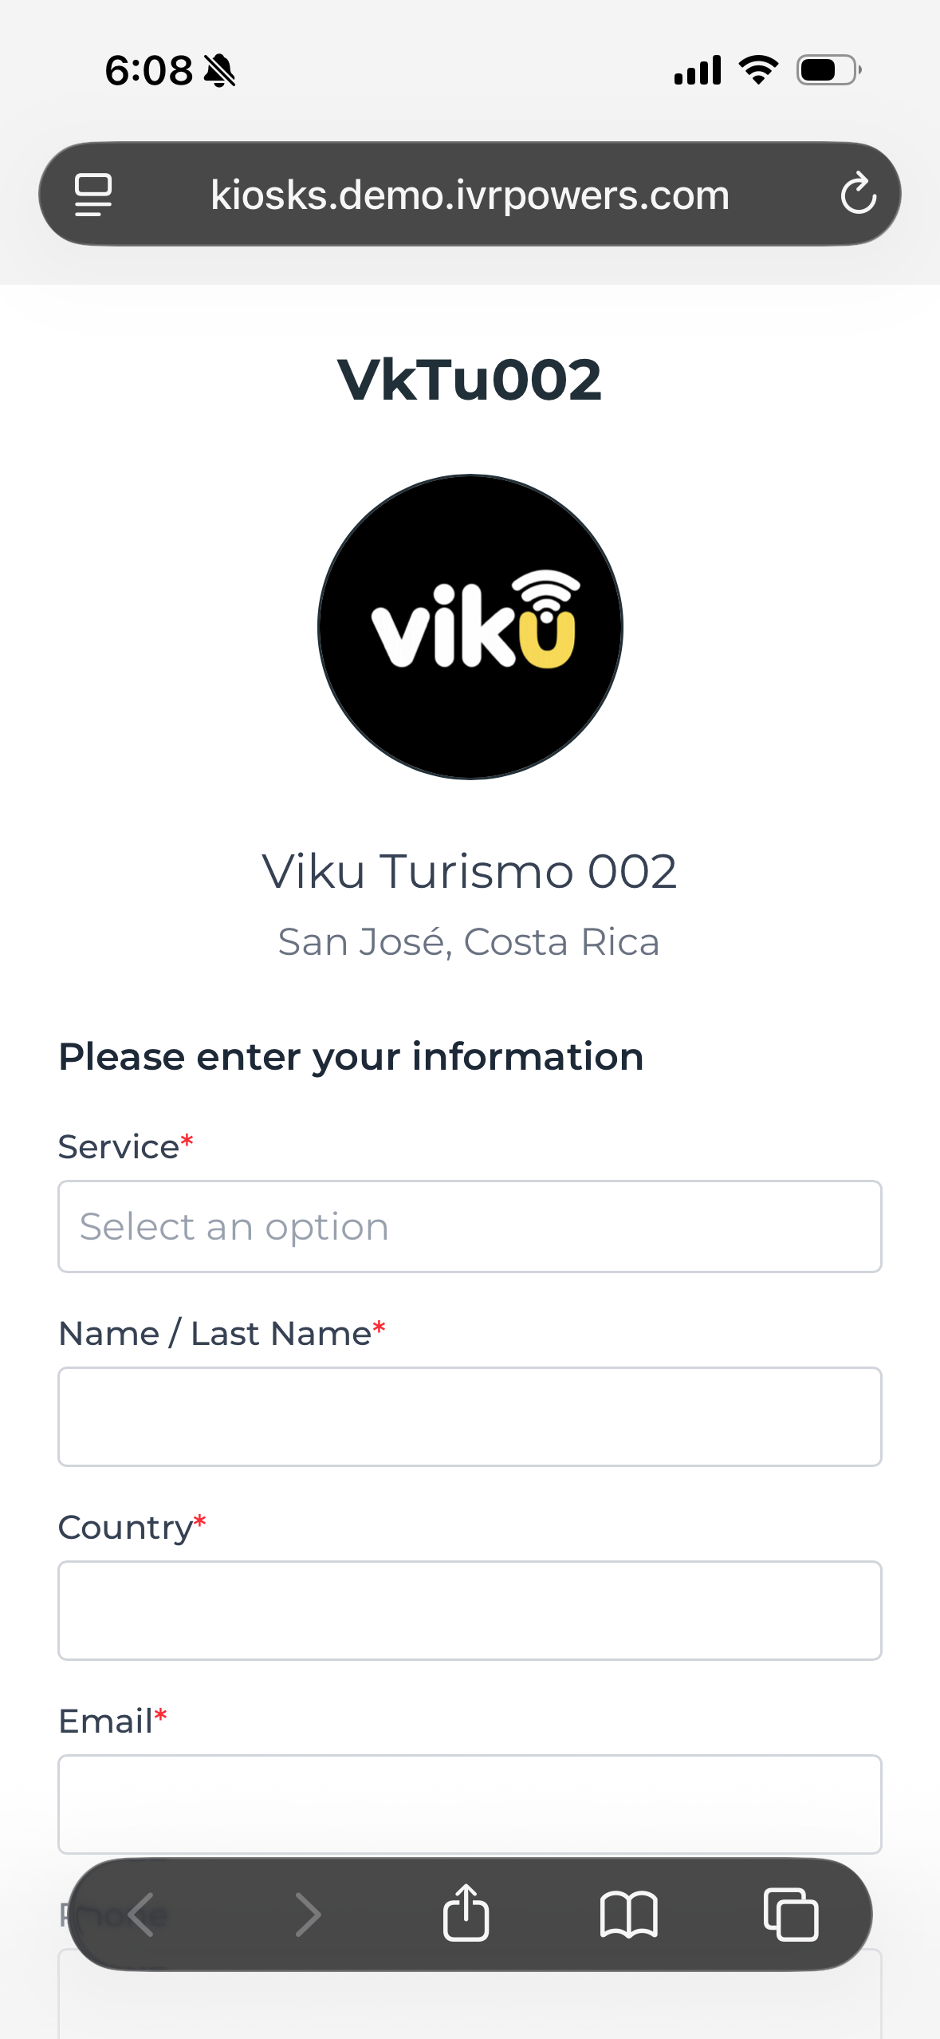








Video Kiosk

PIN required
Botones FAB
Video Call
SPACE HOTEL

Airport Transfers
Direct
Space Hotel Hall
Voice Call

Optional
Su marca
WhatsApp
Optional
90330-20020
ID Posición
PLATINIUM PRIVILEDGES
Scan QR
Selector de Servicios
1632
Metadatos del cliente
Código Promocional, ID, Hab #…



Botones FAB

Slide 9
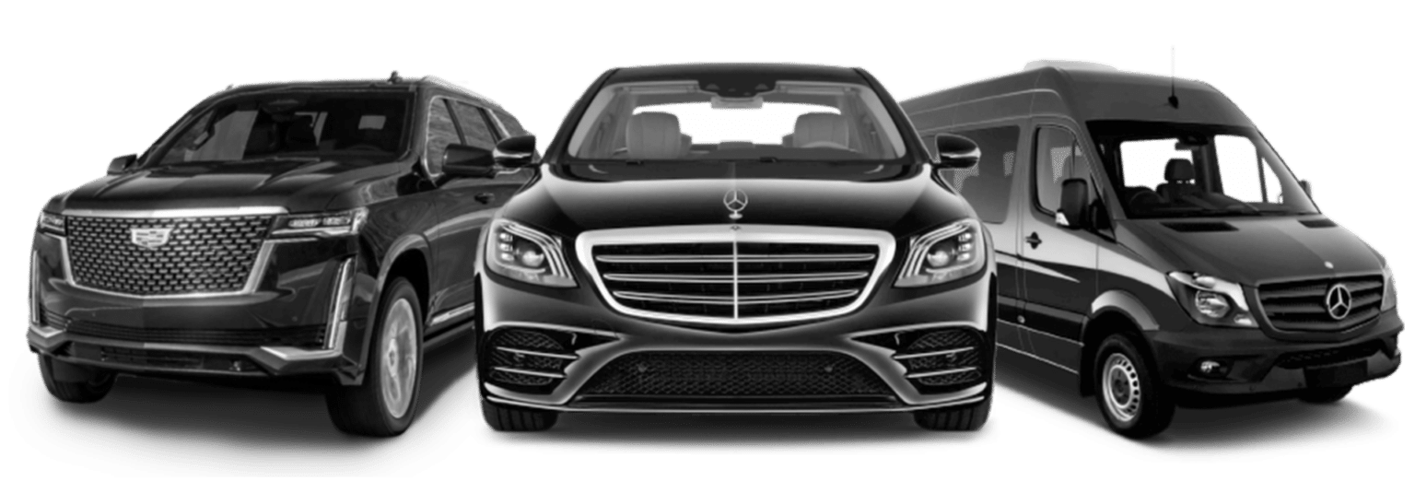
SPACE HOTEL
Airport Transfers
A
A
B
C
PLATINIUM PRIVILEDGES
Airport Transfer Vehicles
1632

Slide 10
s
IntPowers

